Slide 1

To-Dos for New Students
PIASTA Welcome Week
Notes:
Welcome everyone at Hamburg University.
In this Info session I‘d like to present the most urgent to-dos as a new student at Hamburg Uni.

Slide 2

Welcome!
Write us in the chat:
Let us know where you‘re watching from and what you‘re studying!
Copyright: UHH/Göttling

Slide 3
To-dos for new students
New in Hamburg
Find an apartment
Completing enrollment (Immatrikulation)
New to the University
Register in Hamburg
Open a bank account
Apply for health insurance
Apply for a residence permit (Non-EU Students)
Events for first-year students
Getting your semester documents and Deutschland-Semesterticket
Setting up your user ID, university email, and WiFi
Appling for and pick up a library card
For more detailed infomation: To-dos for new students : PIASTA : Universität Hamburg (uni-hamburg.de)
Notes:
At first I‘ll give you an overview about your to dos in Hamburg, as …
Afterwards I‘ll talk about what you need to do as a new student at Uni Hamburg.
In this session, we can‘t answer all of your questions. But we prepared an information brochure where you can find answers to your most urgent questions. LINK

Slide 4

New in Hamburg? Everything you need to take care of!

Slide 5

Accommodation found!
What options are there?
Room in a residence hall run by Studierendenwerk or another organization
Room in a shared apartment
Apartment rented by housing companies or individuals
Notes:
If you‘re moving to Hamburg, the most important thing is that you find an accomodation. Maybe some of you already found a room…
For those of you who are still looking for an accomodation the following information will be useful.
You have various options for accomodation as a student
You can rent a room in a residence hall
You can rent a room in a shared apartment
Or you can look for an own apartement rented by a housing company or individuals

Slide 6
Residence halls
Information
Studierendenwerk Hamburg has 26 resident halls with a total of 4,400 beds.
A furnished room costs approx. €330–€440 per month plus a security deposit of €400.
You have your own room (10–13 m²) and a shared kitchen, common room, and bathroom.
Rooms are for students younger than 36.
Submitting an application for all residence halls will increase your chances.
Rooms are very popular, so expect waiting times.
Complete the online application at www.stwhh.de/en.
The website also has an overview of student residence halls run by other providers with an additional 1,600 beds. (Apply directly to each individual residence hall.)
Erasmus students must have an Erasmus application. ➔ Wohnen für Studierende und Auszubildende (housing for students and trainees)
Notes:
If you want to rent a room in a residence hall:
You can apply for a room at Studierendenwerk Hamburg
Rooms are very popular so expect waiting times
You find all the info on the residences and on the application proceding on the webpage of Studierendenwerk
There you can also apply for a room directly online.
For erasmus: Contact your exchange coordinator at Uni Hamburg to help you with your application

Slide 7
A room in a shared apartment or your own apartment
A lot of students live in shared apartments.
A sublet (Zwischenmiete) is a good possibility for a room at short notice.
To find a room in a shared apartment, use Google, social networks, newspapers, and Internet housing exchanges.
Tip: Create a profile on www.wg-gesucht.de to publish your own request ad.
Apartments are rented by individuals or housing companies.
If renting from an individual, make sure there is a written rental agreement and a handover certificate that describes the condition of the apartment.
To find an apartment, use Google, social networks, newspapers, and Internet housing exchanges.
Tip: Use Saga (www.saga.hamburg) to find an apartment.
Notes:
You can also live in a room in a flat share or in your own apartment:
It‘s sometimes a bit tricky to find a room in a shared apartment, but you can use social networks, google etc to increase your chances. A good plattform is „Wg Gesucht“
We recomend to create a profile and publish your own request ad.
Sometimes a „sublet“ Zwischenmiete is a good solution for rooms and rentals at short notice
Apartments:
If you found an apartement for example via Internet housing exchanges and especially if you rent from an individual:
Make sure you get an Written rental agreement and handover certificate that describes the condition of the apartment.
Tip saga: send an request. But: long waiting times as well.

Slide 8
Semester start is looming and you still have not found a room?
Studierendenwerk (Central Short-Term Rental Office) | Youth hostels | Hamburg Tourist Information
Tel: +49 40 4190-2287 kurzzeitvermietung@stwhh.de https://www.stwhh.de/en/counselling/counselling-centre-accommodation-bewo | www.jugendherberge.de | www.hamburg-tourism.de
Notes:
If you still have not found a room within the next weeks you can go for a short term rental either at studierendenwerk, at youth hostels or at hamburg.tourism. Another option can be Airbnb

Slide 9
What costs will I Incur?
Important: Never transfer money in advance before having signed a contract! You should always be able to view a flat without paying. BEWARE OF FRAUD!
Basic rent (Kaltmiete), incidental expenses (Nebenkosten), and rental deposit (Mietkaution)
  Running costs (e.g., garbage collection and janitor)
  Heating (may be included in rent or may be payable directly to gas provider)
  Electricity and gas (residents sign contracts independently with provider)
  Security deposit (max. three months rent)
  Telephone and internet
  State TV and radio license fees (mandatory monthly fee per apartment: €18.36)
    www.rundfunkbeitrag.de
    ➔ “Informationen für Bürgerinnen und Bürger” ➔ “Studierende, Azubis und Schüler”
Notes:
Basic rent for the apartment or the room and incidental expenses
The basic rent and incidental expenses included are called in German „Warmmiete“

Slide 10
Registered in Hamburg!
Students from non-EU countries need a registration certificate for various purposes (e.g., opening a bank account, residence permit, obtaining a library card). It’s important to register ASAP!
Whether you are moving to Hamburg from abroad or from within Germany, you are required to register within two weeks of your arrival.
If no appointments are available at the Hamburg Service immediately upon your arrival, ensure you secure an appointment within two weeks of your arrival in Hamburg.
If you do not yet have a permanent address, you must register using the address where you are currently staying (relatives, hotel, etc.). Once you find a permanent residence, you will need to register again.
Unmarried individuals without minor children from Germany and EU countries can also register digitally without needing to visit the Hamburg Service in person.
Notes:
When you move to Hamburg, and once you‘ve found an accomodation:
you have to register at the Kundenzentrum within two weeks, or at least make an appointment to do so
Because of long waiting times it‘s important that you make an appointment well in advance.
Which documents do you need for the registration?
Passport or id
Completed registration form
Completed landlord‘s confirmation
12 euros (in cash)
After your registration you get the registration certificate. This is a very important document!!

Slide 11
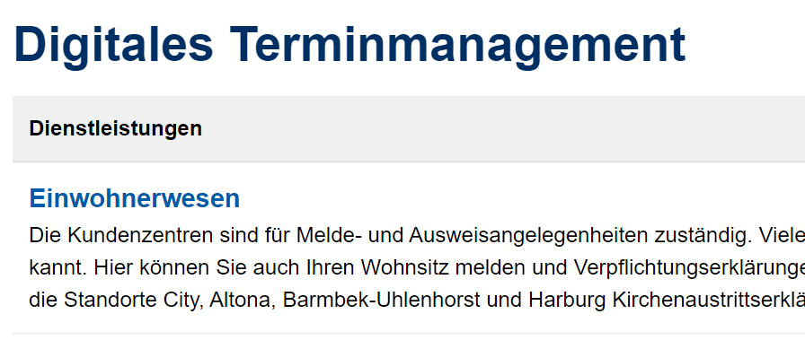
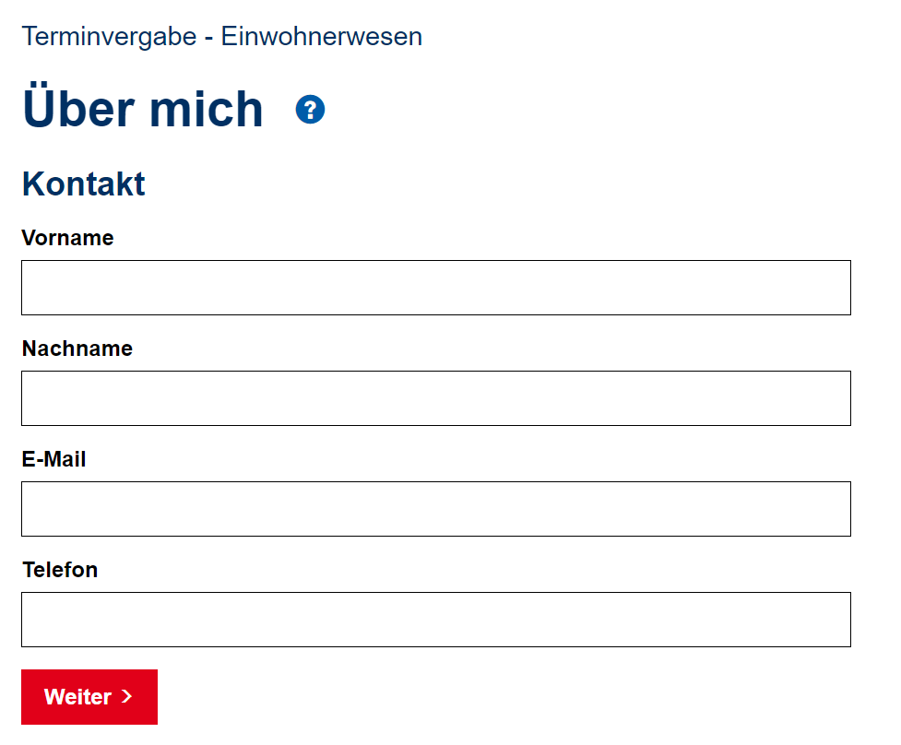
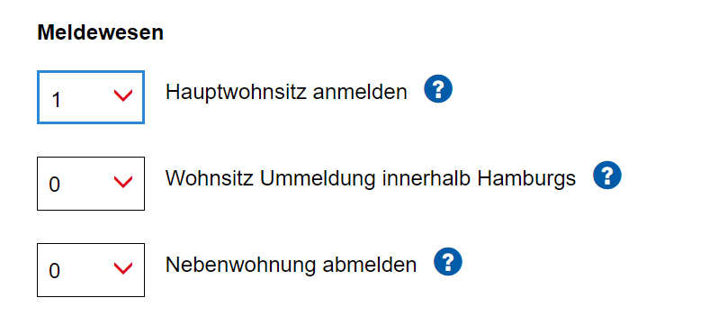
How do I make an appointment?
Tip:
Book at any customer service center that has available appointments; it does not have to be your local customer service center.
  Digitales Terminmanagement (hamburg.de)
Click on Einwohnerwesen
Datenschutzerklärung zustimmen (Agree to the Privacy Policy)
Kontaktdaten eingeben (Enter your contact details)
Anmeldung der alleinigen Wohnung oder der Hauptwohnung (Register your main address)
Termin buchen (Book an appointment): Simply choose a Hamburg Service location in a district where appointments are available, regardless of the district you live in.

Slide 12
What do I need to bring to the appointment?
A personal ID or passport.
A completed and signed registration form.
A completed and signed confirmation of housing (Wohnungsgeberbestätigung).
Fee: € 13

Slide 13
How do I register online? (for unmarried individuals without minor children from Germany EU countries)
Simply register your new address in Hamburg online.
You will receive a digital registration confirmation.
Updates to your personal ID, passport, or eID card can also be made through the online service.
Hamburg Service Account Plus (if you do not have one, you can set it up at Serviceportal Hamburg ➔ Ihr Servicekonto ➔ Registrieren ➔ als Privatperson ➔ Servicekonto Plus).

Slide 14
Requirements for using the new online services:
Personal ID with activated online ID function.
Hamburg Service Account Plus (if you do not have one, you can set it up at serviceportal.hamburg.de).
AusweisApp2.
EU citizens and residents of the European Economic Area can also use the online service, for which an eID card is needed.

Slide 15
Opened a bank account!
Open a bank account at a bank in Hamburg or with an online bank.
They are usually free of charge for students but credit cards aren’t typically free.
Important for paying rent, your health insurance payments, your semester contribution to the University, and credit card payments (credit cards are not accepted everywhere).
You will need your passport or identification card, registration certificate, and proof of enrollment (from your STiNE account).
Notes:
Why do you need to open a bank account?
You need it to transfer your rent , health insurance payments, semestercontribution etc.
Also credit card are not accepted everywhere in Germany. Therefore it‘s also usefull to have a normal bank card from a german bank.
What do you need to open a bank account?
Passport or id
Registration certificate
Proof of enrollment (from stine)

Slide 16
Got health insurance!
German students | Students from EU countries | Students from non-EU countries
They are usually insured under their parents’ policies until the age of 25. | They can keep their foreign health insurance if they have been issued a European Health Insurance Card (EHIC). The EHIC does not ensure free health services. Be sure to get accurate information! | Foreign health insurance is often not recognized, and travel insurance is not enough. You will need to take out German health insurance!

Slide 17
Got health insurance in Germany!
German students are typically covered under their parents' insurance until the age of 25, as long as their own income does not exceed certain limits. From age 26 or with an income over 505 euros per month (556 euros for minor jobs, as of Jan. 2025), they must secure their own insurance.
Students from EU countries can generally remain with their foreign health insurance if they have a European Health Insurance Card (EHIC). It is essential to check with your health insurance provider in your home country about which treatments and medications are covered for free in Germany and which costs you will need to bear. The EHIC does not guarantee free treatment! If EU/EAA students relocate their primary residence to Germany during their studies (e.g., through self-funding, marriage, or children), they must insure themselves with a German health insurance provider.
Students from non-EU countries: Health insurances from non-EU countries are generally not recognized, and travel health insurances are not sufficient for studying in Germany, neither for university enrollment nor for obtaining a residence permit from the immigration authorities. Therefore, non-EU students usually need to obtain German health insurance.

Slide 18
Applying
In most cases, you can apply for health insurance and upload your documents online.
You will need a photo and your proof of enrollment.
Beratungszentrum Soziales & Internationales – BeSI (Social and International Advisory Center)
Advice is available via phone, email, or in person – several times a week, with or without an appointment!
On the BeSI website, you will find current opening hours as well as helpful and detailed information on health insurance. You can also book an appointment for a personal consultation.
Notes:
If you have questions or if you are not sure how to apply for a health insurance:
You get advice at the counselling center for social and international affairs (BeSi)
- You can write them an email or go to the personal counseling hours.

Slide 19
Applied for a registration certificate (EU students)!
International students from EU countries do not need a visa.
A registration certificate serves as proof that EU and EAA citizens have the right to reside and travel in Germany.
However, family members from third countries must have a residence card from the immigration authorities (proof: family status, sufficient funds to cover costs of living, health insurance).
Notes:
Check slide 9 & 10!
For EU Students your registration certificate serves as proof to reside and travel in Germany – you can get this at any Einwohnermeldeamt/registration office in Hamburg. You need to apply for an appointment before online: https://www.hamburg.de/behoerdenfinder/info/11262214/n0/

Slide 20
Applied for a residence permit (non-EU students)!
Students from non-EU countries must apply for a residence permit for their studies. This permit is valid for a maximum of two years and must be regularly renewed during your studies.
The waiting time for an appointment at the Ausländerbehörde (Immigration Authority) ranges from several weeks up to two or three months.
If you entered Germany with a visa, make sure to book your appointment before your entry visa expires.
If you were allowed to enter without a visa, you can stay for up to 3 months without one. Book your appointment shortly after arriving in Hamburg.
Notes:
For non EU students you have to apply in time for your residence permit
So, once you entered Germay make an appointment at your local immigration authority
More information you can find here: https://www.hamburg.com/welcome/entry-residence/education-family/11745512/students/

Slide 21
Applied for a residence permit (non-EU students)!
Which Ausländerbehörde should I go to?
If you apply for a residence permit in Hamburg for the first time, the Hamburg Welcome Center is responsible for processing your residence permit application.
For further applications the foreigner's office in the district where you reside will be responsible.
When you book your appointment online, you will automatically receive an appointment with the authority responsible for you.
Notes:
For non EU students you have to apply in time for your residence permit
So, once you entered Germay make an appointment at your local immigration authority
More information you can find here: https://www.hamburg.com/welcome/entry-residence/education-family/11745512/students/

Slide 22
Applied for a residence permit (non-EU students)!
How?
Make an appointment online at Residence Permit Hamburg - Online-Dienst Einstiegsseite - HamburgService
The waiting period for an appointment can take anywhere from several weeks to two months.
You can pick up your residence permit (similarly to your personal ID) four weeks after your appointment at the earliest.
You will receive a letter, after which you must book your own appointment online to pick up the permit.
Notes:
Make an appointment at your local immigration authority – see link
Important: long waiting times, so make an appointment well in advance
After your appointment: It takes more or less 4 weeks until you can pick up your residence permit
Once your residence permit is ready, you‘ll receive a letter. You have to make an extra appointment to pick it up.

Slide 23
What you will need
Fully completed application form (available in many languages)
National passport and biometric photo (not older than 6 months)
Current registration certificate (how to obtain your registration certificate is explained under registration in Hamburg)
Proof of health insurance
Current student enrollment certificate
Proof of financial resources (bank balance of 992€ per month or 11,904€ for one year or net income over 812€ per month) or a declaration of commitment
The fee for an electronic residence title is 110€ (payment in cash or by EC card only, credit card payment is not possible).
  More info: www.welcome.hamburg.de/studium-und-forschung/4651370/aufenthaltserlaubnis-fuer-studierende
Notes:
Here‘s a list of what you need for your appointment:

Slide 24
Advising
The International Department at the University of Hamburg offers advice for international students on all questions related to the residence permit for studies.
International Student Support
Email: international-student-support@uni-hamburg.de
Notes:
The department of international affairs of Uni Hamburg offers Advising for international students.
So whenever you have a problem or questions, you can ask the team of the international student support for help.

Slide 25
To-dos at the University

Slide 26
Enrolled! Step 1 for Exchange Students
After online enrollment, you will receive your provisional semester documents (valid only for April or October) and a one-month Deutschland-Semesterticket (valid only for October).
Erasmus and other exchange students enroll at Universität Hamburg by completing the online application in the STiNE portal.
1. Create an applicant account ➔ Bewerberaccount anlegen (create an applicant account)
2. You will receive your login details by email.
3. Log in with your new login details on the same website and select your field of study and the application process for "Guest Programs for International Students (Erasmus and Freemover)".
4. Please provide your coordinator's institute address in your online application.
5. Fill out the application and submit it electronically.
Instructions for the Online Application
Notes:
Is there anyone of you who‘s not enrolled yet?
When you are accepted for a playe at the Uni you get an acceptance letter.
This letter includes an enrollement deadline.
This deadline is very important: If you don‘t meet the deadline, you‘ll lose your place at the Uni
So one you got your acceptance letter got to Stine and click on….
After you did your online enrollemnt, you‘ll receive your provisional semester documents via post mor or less four weeks after your enrollment deadline

Slide 27
Enrolled! Step 1 for Degree Students
After online enrollment, you will receive your provisional semester documents (valid only for April or October) and a one-month Deutschland-Semesterticket (valid only for October).
Your Zulassungsbescheid (notice of admission) from Universität Hamburg states your enrollment deadline, which you must meet. The deadline usually ends seven days after receiving your notice of admission. If you don't enroll on time, you will lose your study place.
The online enrollment in your STiNE applicant account is straightforward: You fill out everything online and upload all the required documents.
The documents you need to upload vary depending on nationality, field of study, etc. For example, international bachelor's students must upload proof of German language skills in addition to their higher education entrance qualification, and for certain programs like medicine, sports, or teaching, additional proof is required.
Here you can find the checklists from the Campus Center.
After your online enrollment, you will receive an automatic email confirmation. If you don't receive an email, check your spam folder. If you still can't find an email, contact the Campus-Center.
Notes:
Is there anyone of you who‘s not enrolled yet?
When you are accepted for a playe at the Uni you get an acceptance letter.
This letter includes an enrollement deadline.
This deadline is very important: If you don‘t meet the deadline, you‘ll lose your place at the Uni
So one you got your acceptance letter got to Stine and click on….
After you did your online enrollemnt, you‘ll receive your provisional semester documents via post mor or less four weeks after your enrollment deadline

Slide 28
Enrolled! Step 2: Health Insurance
You should take care of everything no later than two weeks before the provisional semester documents expire.
Universität Hamburg requires a report of your insurance status from a German public health insurance provider.
This report can be submitted after the enrollment deadline. For full enrollment and final semester documents (valid for a semester, unlike the provisional semester documents, which are only valid for one month), the university must receive the report. Therefore, take care of this as soon as possible, so you receive your Deutschland-Semesterticket on time.
If you are insured with a German public health insurance provider, ask your provider to report your status to Universität Hamburg. You can often do this online.
If you have a European Health Insurance Card (EHIC) or are insured with a German private health insurance provider, ask a German public health insurance provider to notify Universität Hamburg that you are exempt from mandatory insurance. There are offices of public health insurance providers near the campus. You can go in person or contact them via email and handle everything while you are still abroad. In the case of the EHIC, the health insurance provider will need a scan of the EHIC and your passport.
Notes:
Then you have to transfer the semester contribution
Also, you have to proof your health insurance
When you have a German provider: the provider inform the Uni and you don‘t need to do anything here
If you have a private insurance or are a member of EHIC: The provider has to notify Uni Hamburg that the student is exempt from German public health insurance

Slide 29
Enrolled! Step 3: Pay/Transfer Semester Contribution
You should take care of everything no later than two weeks before the provisional semester documents expire.
The semester contribution for the winter semester 2025 is €384. (There are exceptions, for example, Erasmus students pay a lower contribution.)
The semester contribution is not a tuition fee; it includes, for example, a Deutschland-Semesterticket for public transport.
After processing your online enrollment, the Campus Center will send you your new user ID by email. In your STiNE account under ➔ Studying ➔ Documents, you will find the amount you need to pay and the bank details of Universität Hamburg.
Notes:
Then you have to transfer the semester contribution
Also, you have to proof your health insurance
When you have a German provider: the provider inform the Uni and you don‘t need to do anything here
If you have a private insurance or are a member of EHIC: The provider has to notify Uni Hamburg that the student is exempt from German public health insurance

Slide 30
Got your semester documents!
Procedure for Erasmus and exchange students:
Enrollment: Apply online via STiNE; pick up semester documents from your coordinator.
You will receive the permanent semester documents only after
you pay the semester contribution
Universität Hamburg receives proof of your insurance coverage from your provider
you upload all required documents. Make sure you submit proof of German/English language proficiency by the deadline!
  www.uni-hamburg.de/einschreibung
  www.uni-hamburg.de/deutschkenntnisse
If you move, remember to register your new address at www.uni-hamburg.de/studium.
Notes:
After you uploaded all the required documets and especially your proof of German language proficiency, after you payed the semester contribution and the Uni received the proof of your health insurance provider
You get your permanent semster documents.
Via post! So if you move make sure to register your new adress

Slide 31
No semester public transport pass at the beginning of the semester?
You can purchase a travel pass yourself and you will be reimbursed later.
What do I need to keep in mind?
  Only weekly or monthly passes from the Hamburg Public Transport Association (HVV) that bear your name will be reimbursed.
  Single tickets will not be reimbursed.
  The weekly or monthly pass may only be valid as of 1 April (summer semester) or
  1 October (winter semester), respectively.
Buy a weekly or monthly pass in the online shop, with the app, or in the service centers at the larger train stations.
Apply for the costs to be reimbursed as soon as you have received your semester public transport pass.
  Email a scanned copy of your semester public transport pass to the S-Bahn Fahrgeldstelle at info@sc-fahrpreisnacherhebung.de.
  You will have to enter the email address you used to buy your online ticket.
Notes:
Semster starts and you still don‘t have your public transport pass?
Buy a travel pass yourself and get reimbursed later
BUT only weekly or monthly passes from the public transport association of Hamburg (HVV) will be reimbursed.
This should only be valid as of 1 April.
Then you should apply for the costs to be reimbursed as soon as you have recived your semester public transport pass.

Slide 32

Semesterticket = Deutschlandticket
With the Deutschland-Semesterticket, you can travel on all public transport (e.g., regional trains) throughout Germany (not valid for ICE, IC/EC). Here’s how to get the HVV Deutschland-Semesterticket from HVV (Hamburger Verkehrsverbund) on your smartphone:
You can access the ticket portal via the Universität Hamburg website.
Click "Login" on the ticket portal and log in with your new Universität Hamburg user ID.
Clicking on the ticket will take you to the control view. There, you can also move your ticket to your smartphone wallet app. You should have "automatic updates" enabled here, so your ticket is up to date in case of a check.
If only the provisional ticket is displayed, it means that your health insurance report and/or the semester contribution is still missing.
Copyright: UHH/Esfandiari
Notes:
Neue Folie: Info zu Semesterticket = Deutschlandticket (just copied it out of the e-mail from the campus-center about the new digital semesterticket)
Das Semesterticket wird digital zur Verfügung gestellt. Die Bereitstellung erfolgt direkt durch den HVV. Der genaue Weg der Bereitstellung steht noch nicht endgültig fest. Sie erhalten rechtzeitig weitere Informationen dazu per E-Mail und über die Webseite des Campus-Center: www.uni-hamburg.de/ticket

Slide 33
IDs and supporting documents on hand!
You will receive a uni username and a one-time password by post or email.
Set a new password! (Tip: Enter your phone number as well.)
Change your password at www.bv.uni-hamburg.de.
Don’t worry— your uni and STiNE usernames are the same.
You will need your uni username to access STiNE and all IT services provided by the Regional Computing Center (RRZ).
The semester documents consist of:
Enrollment certificate (in the STiNE account under "Documents")
TAN list, which you'll need later for course registration (sent by email)
Deutschland-Semesterticket (digital, downloadable from the ticket portal)
Notes:
You receive an uni username and a one-time passport with your provisional semester documents
This new username replaces your previous applicant username.
In order to activate your new uni unsername change your password
Your uni username you need to access Stine and all IT-services by rrz

Slide 34
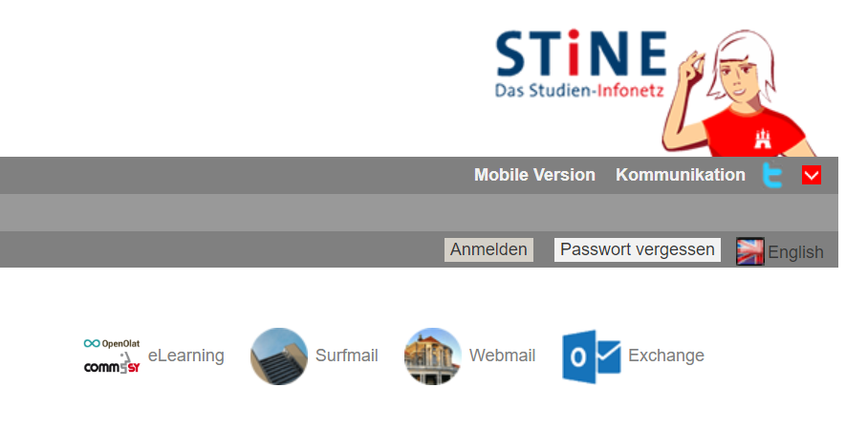
IDs and supporting documents on hand!
Login: https://surfmail.rrz.uni-hamburg.de
You will receive an email address for your University email account:
  firstname.lastname@studium.uni-hamburg.de
Notes:
You also need your uni username for your uni email account
Login: https://surfmail.rrz.uni-hamburg.de
Your email account includes two email adresses
First name. Last name
Or uni username

Slide 35
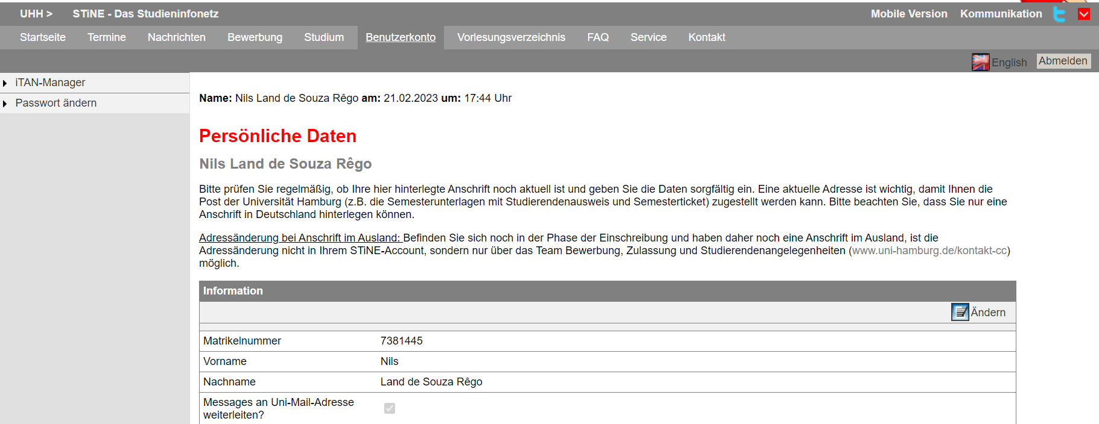
Communication
IT Services and University Wi-Fi – Information Session Offered by the Regional Computing Center (RRZ)
Tuesday, 30.09.25, 2:30 PM in German & 4 PM in English
Registration via UHH Join
More information
STiNE
Surfmail
(@studium.uni-hamburg.de)
Not an email system—an internal news portal run by the University
Linking to Surfmail: STiNE portal → Account → Forward messages to uni-mail-account → Change
All students have their own University email address
  Instructional video to set up your student email address (DE/EN)
Important! When communicating with teaching staff, academic advisors, classmates, and any other university staff, you should always send mails using your uni-hamburg.de email address. This is to ensure you are who you say you are.
Linking to your private email address:
  Surfmail → Filters→ Forward → enter desired email address → Save
Notes:
Link Lehrvideo: https://www.uni-hamburg.de/newsroom/campus/2022/1011-film-studi-mailadresse.html
Stine (English): Account → activate „Forward messages to uni-mail-account“ → Change
Surfmail (English (USA)): Mail → filters → forward → enter your private Mailadress → Save
Wichtige Informationen vonseiten der Uni, von euren Dozierenden oder auch Benachrichtigungen über die Online-Tools (Agora, OpenOlat etc.) werden an Stine oder eure Surfmail geschickt. Um keine Benachrichtigung zu verpassen, ist es deshalb wichtig eine Weiterleitung an eure private Mail einzurichten.
WICHTIGER HINWEIS: Bitte überprüft nach der Verknüpfung, ob die Mails auch tatsächlich weitergeleitet werden! Schaut vorsichtshalber zu Beginn immer in beide Portale mal rein

Slide 36
Informed about planning and starting your studies!
Academic regulations and subject-specific provisions (FSBs) | Course catalog | Forms for Erasmus and exchange students
www.uni-hamburg.de/campuscenter ➔ “Organizing your studies > Regulations, information sheets, forms > Exam and academic regulations” | www.stine.uni-hamburg.de ➔ Course catalog | https://www.uni-hamburg.de/en/internationales/studierende/incoming/austausch-gaststudium/erasmus-incoming.html
Notes:
Once you‘ve received your documents and the semster has started:
Get familiar with the legal frameworks of your studies. There are academic regulations and subject-specific provisions where you find all the regulations, your obligations as well as the strcture of your program.
Your personal course plan is based on the academic regulations, the course catalog. Each semster you have to register for your courses yourself. But don‘t worry: You will learn how to set your course plan at your OE orentation module

Slide 37
Taken note of first-semester events and dates!
Information Session on University Sports Hamburg and BEAT! (student health management)
Friday, 02.10.25, 10 AM in German & 11:30 AM in English
Registration via UHH Join
Erasmus welcome
  https://www.uni-hamburg.de/internationales/studierende/outgoing/austausch-gaststudium/erasmus/ansprechpartner.html
PIASTA Welcome Week for new students
  Varied program, information, getting to know the University and other students
  www.uni-hamburg.de/welcome and www.uni-hamburg.de/piasta
Orientation module
  One week before the start of your studies, you will learn how your program works and get to know your fellow students.
  Most degree programs email new students an invitation.
  www.uni-hamburg.de/oe
Notes:
Most faculties organize an extra welcome event for erasmus students. Infos on those events will be provided from your coordinator
This week: welcome week
Next week: Orentation modules: get to know your fellow students, plan you semester and register for your courses

Slide 38
Who can help me further?
Information session: Who, where, what? A short guide to the University
Thursday, 14:030 am (German)
Thursday, 16:00 am (English)
Register via UHH Join!
IT questions
Administrative questions
Non-subject-specific questions and help with your studies
Subject-related questions
I cannot log into my University email account.
How can I get Wi-Fi on campus?
STiNE problems
How do I pay the semester contribution?
I need a new semester ID
I have a new address. What should I do?
I want to change subjects
How do I launch a career?
Mental Health support
Workshops and writing consultations
How do I register for a module?
What courses do I have to take?
Transcript of records
Regional Computing Center (RRZ)
Campus Center
Your faculty’s academic office, departmental student rep committee (FSR), and teaching staff
Campus Center, PIASTA, Writing Center, and
Career Center
Notes:
The Uni Hamburg is a big institution and it‘s not alway clear where you have to adress your questions. Therefore we prepared this overview.
In case you have IT questions, for example…
NEU: Anordnung, Farben, Daten
Links:
Service-Line und STiNE-Line RRZ: https://www.rrz.uni-hamburg.de/beratung-und-kontakt/serviceline.html
Campus Center: https://www.uni-hamburg.de/campuscenter/beratung/beratungseinrichtungen.html
Piasta: https://www.uni-hamburg.de/piasta/ueber-uns/piasta-info.html
Schreibzentrum: https://www.isa.uni-hamburg.de/schreibzentrum.html
Career-Center: https://www.uni-hamburg.de/career-center.html
LINKS IN DEN CHAT! VORBEREITEN
Kommt auch zu unserer Veranstaltung Wer, wie , wo …
Termine einfügen

Slide 39


We can’t wait to meet you!
PIASTA offers during the semester:
Cultural events and leisure activities
Seminars and workshops
Language offers
For new students
Advising
International nights
Copyrights: Universität Hamburg / PIASTA
More information and registration at:
PIASTA Welcome Week | How Does Studying Work?
Notes:
UHH Join: https://www.uhh-join.uni-hamburg.de/de/#rvb
PIASTA: https://www.uni-hamburg.de/piasta/

Slide 40
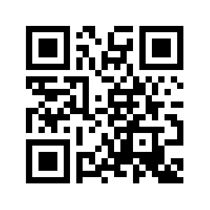

How can you stay in touch with us?
PIASTA on Instagram
Info about upcoming events and offerings
instagram.com/piastauhh
Sign up here!
PIASTA website
Overview of all our events and advisory services that we offer
You can register for all our events via UHH-Join
Newsletter
Info about upcoming intercultural learning opportunities and workshops
Job offers for students
General info about PIASTA Events
Notes:
Leuten 2-3 Min Zeit geben, sich beim Newsletter anzumelden und Folgen!
Instagram: instagram.com/piastauhh
Newsletter: https://www.uni-hamburg.de/piasta/mitmachen/newsletter.html
Website: https://www.uni-hamburg.de/piasta/
UHH Join: https://www.uhh-join.uni-hamburg.de/de/

Slide 41
Online survey about Welcome Week
We work hard to plan events and activities and would love to get your feedback.
Our team will hand out a QR code for a questionnaire at in-person events. After you have taken part in your last event of the week, let us know how the week went for you.
No QR code? No problem. At the end of Welcome Week, we can also give you an email link for the online questionnaire.
After your last event at the end of the week, take a few minutes to answer the questions.
Thank you!

Slide 42
Time for questions ☺
Thank you for your time!
Notes:
Vorbereitung auf häufige Fragen bei den "eigenen" Veranstaltungen: Semesterticket, OEs, Ausländerbehörde - bei Präsentieren Wegweiser auf die Zeit achten. Genug Zeit für Fragen einplanen. (unter PPT-Notizen auf letzter Folie bei allen Info-VA einfügen)
Auf UHH.de/OE verweisen oder sonst an Studienbüro des Studiengangs verweisen
Semesterticket: Ich habe mein Ticket noch nicht erhalten – ist das schlimm oder nicht? Vergewissern, dass alle Doks eingereicht sind (Im Zulassungsbescheid nachschauen). Bei Int Stud. Insbesondere vergewissern, dass DE-Nachweise eingereicht wurden. Kann 2-3 Wochen dauern. Bei Unsicherheit ans Campus-Center wenden und nachfragen. UHH-Homepage zeigen und auf Service-Phone verweisen: https://www.uni-hamburg.de/campuscenter/beratung/info-beratung-telefon.html
Nachweise der KV müssen nicht mehr eingereicht werden, sondern die gesetzlichen geben Meldung an die Uni durch. (to-do-Broschüre durchgehen!)
Ausländerbehöre: Bei den Behörden in HH gibt es sehr lange Wartezeiten. Die beste Art der Terminbeantragung ist die Online-Beantragung, weil man da schon Online Dokumente hochladen kann. Deswegen kümmert euch frühzeitig vor Ablauf der Aufenthaltselaubnis um Termin kümmern! Keine Sorge, ihr bekommt sonst eine sog. Fiktionsbescheinigung. Damit könnte es allerdings Schwierigkeiten bei Wohnungs- und Arbeitssuche geben.
Prüfungsanmeldung: auf OE bzw. Studienbüro verweisen.

