Slide 1

Who, What, Where? A Short Guide to the University
PIASTA Welcome Week

Slide 2
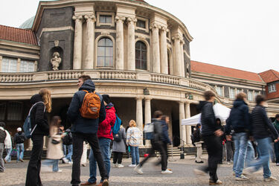
Welcome to our information session!
Let us know where you’re watching from and what you’re studying!
Copyright: UHH/Göttling

Slide 3
Guide to Universität Hamburg
Who can support me in organizing my studies?
Where can I find help with questions and challenges?
What extra learning opportunities are available to me?
How can I get involved in political and inter/ transcultural activities?
What leisure and recreational options does the University offer?

Slide 4

1. Who can support me in organizing my studies?
16.08.2025
Notes:
Hier geht es wirklich nur um Organisatorisches: also z.b. Wohnen und Finanzen, Kinderbetreuung, Einschreibung etc.

Slide 5
Organizing your studies
Campus Center
Regional Computing Center (RRZ)
State and University Library (StaBi)
Around the faculty
Studierendenwerk Hamburg

Slide 6
Around the faculty: academic office and departmental student representative committee
Academic office:
First point of contact for questions about planning and organizing your studies
STiNE (e.g., course selection, entry of completed coursework, and examination registration)
Advice on required and elective subjects
Departmental student representative committee (FSR):
Organization of orientation modules (OEs)
Student advising service for study-related matters
Further advising bodies : Studies : Universität Hamburg (uni-hamburg.de)
Notes:
Studienbüro der Fakultät

Slide 7
Campus Center
Studies : Universität Hamburg (uni-hamburg.de)
Applications and admissions
Enrollment
All further administrative processes during your studies (e.g., semester public transport pass and semester contribution)
Service Point and Service Telephone
First point of contact for any questions about studying at Universität Hamburg
Information and Advising on the Phone : Studies : Universität Hamburg (uni-hamburg.de)
Campus Center Forum
Online information and advising
Information and Advising Online : Studies : Universität Hamburg (uni-hamburg.de)
Notes:
For general non-subject-related issues

Slide 8

Studierendenwerk Hamburg
Home: STW Hamburg (stwhh.de)
Accommodation
26 residence halls with around 4,400 places
Counselling Centre Accommodation (BeWo) for questions about accommodation
Social and international affairs
Social, personal, and financial problems
Students with children, international students, and students with chronic illnesses
Counselling Centre for Social and International Affairs (BeSI) for questions about social or international affairs
Student financing
Federal student loan scheme, grants, scholarships, and funding abroad
Counselling Centre for Study Financing (BeSt) for questions about financing your studies
Studying as a parent
Childcare centers
Accommodation for single student mothers
Flexible childcare services at Family Service
Notes:
Several advice and consultation offers: BeSI f.e. for help with health insurrance

Slide 9

Regional Computing Center (RRZ)
Regionales Rechenzentrum : Universität Hamburg (uni-hamburg.de)
STiNE
Wi-Fi and VPN
University email
Software for your studies
Technical support
Equipment rental
Contacting the RRZ:
Tel: +49 40 42838-7790, Mon–Fri: 9am - 3pm
rrz-serviceline@uni-hamburg.de
Notes:
Everything related to IT-Issues

Slide 10
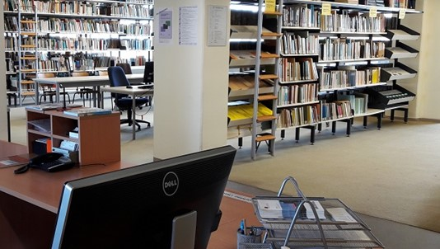


State and University Library Carl von Ossietzky (Stabi)
Digital catalog
Workstations
Database access
Borrowing and picking up books
Central library for all subjects
ONLY subject-specific books in departmental libraries
mehrsprachig ǀ SUB Hamburg (uni-hamburg.de)
Notes:
There are different libraries that are part of the library network. At the stabi you can register for a library card, with which you have acces to all libraries – for registration you will need to bring your id-card/passport, student-ID (in order to get the card for free) and the registration form/certificate (that confirms your adress)
In most of the libraries you can go to study – keep in mind, that every library has different opening hours and rules (what you are aloud to take inside with you)

Slide 11
2. Where can I find help with questions and challenges?

Slide 12
Advising
Campus Navigator of Universität Hamburg (uni-hamburg.de)
Department of International Affairs and PIASTA
Family Office
Office for Students with Disabilities and Chronic Illnesses
Complaints offices at Universität Hamburg
Campus Center
AStA (student council)
Notes:
Recomending the campus navigator: it´s like the google maps of the university with all the institutions. Where to find them and contact information: https://www2.uni-hamburg.de/onTEAM/campus/

Slide 13
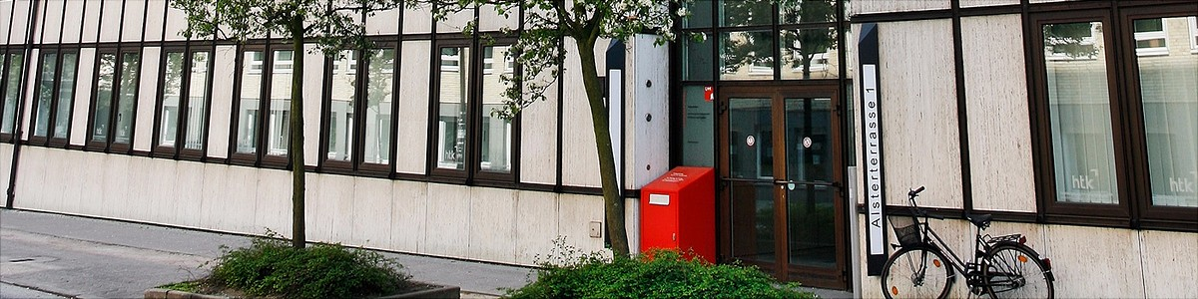
Campus Center
Center for Academic Advising
Services for prospective students, including refugees
Advice on all questions related to your studies (e.g., performance pressure, stress, exam anxiety, and time management)
Advice on dealing with doubts regarding studies (continue, change, or drop out?)
Psychological counseling
For worries and needs (e.g., self-doubt, learning difficulties, and fears)
Advice on sexual harassment, discrimination, and violence
Support for students with mental illness (HOPES)

Slide 14


Department of International Affairs and PIASTA
International : Universität Hamburg (uni-hamburg.de)
For international students:
International student support: advice on residential, social, and personal matters
Björn Stehn (attorney): legal advice
Dominik Meckel : advice on scholarships
For all students:
Studying abroad (Erasmus+, worldwide, scholarships)
Certificate Intercultural Competence (CIC)
Notes:
CIC: as part of the CIC are our intercultural seminars & workshops which take place during the semester.
Participation in our CIC program is free of charge! We hope it is understood as a reward for students particularly devoted to promoting intercultural awareness and understanding.
Component A: Intercultural Training (mandatory)
Component B: International Experience
Component C: Campus International - proof of intercultural involvement at Universität Hamburg (f.e. AIESEC, Buddy-Programm etc.)
Component D: Intercultural Studies

Slide 15

Family Office
Family Office : Universität Hamburg (uni-hamburg.de)
Family-friendly studying Parental leave
Leaves of absence Regular childcare
Notes:
tips and info about balancing studies and family life while studying
Info and resources about childcare and nursing care

Slide 16
Office for Students with Disabilities and Chronic Illnesses
Studying with Impairments : Universität Hamburg (uni-hamburg.de)
Consultations
Statements for teaching staff and examinations boards
Organization of visits and events
Introduction to using assistive technologies
Notes:
with hearing, vision, voice, and other physical impairments and chronic physical disabilites as well as mental health conditions and learning disabilities

Slide 17
Advice and help
Complaints offices at Universität Hamburg : Studies : Universität Hamburg (uni-hamburg.de)
Conflicts related to examinations:
Ombudspersons (lecturers or student body representatives) in every faculty
Discrimination during your studies:
Discrimination Complaints Office for Students
Goal is discrimination-free environment for studying at Universität Hamburg
Sexual harassment, discrimination, and violence:
Campus Center Contact and Advising Services
Discrimination Complaints Office for Students

Slide 18
AStA (General Student Committee)
https://www.asta.uni-hamburg.de/
Academic, legal, and personal advising
Advice on federal student loan scheme
Labor law advice
Tax advising for students
Semester public transport pass hardship fund
Advice for students with children
Student-to-student psychological counseling
The semiautonomous sections continue to provide advising services in the following areas:
For students with disabilities and chronic illnesses
For international students
For women and trans, intersex, and nonbinary people
Notes:
AStA represents the interests of all students at the university. Every year, students elect the Student Pariliament, which appoints AStA
AStA represents us students at university, the city, and the public. They office advice, support with everyday university issues, and negotiate benefits on our behalf. They also organize cultural and political events. Their main goal is to imrpove studying conditions.

Slide 19
3. What extra learning opportunities are available to me?

Slide 20
Additional Learning Opportunities
Writing Center
Campus Center
Campus Center and Center for Academic Advising
Learning other languages
PIASTA
Notes:
I can recommend to engage in activities besides your career, if possible. To take your study-time to try out new activities and find out your interests and passions.

Slide 21
PIASTA seminars and workshops
Seminars and Workshops : PIASTA : Universität Hamburg (uni-hamburg.de)
Diversity skills
Intercultural experience
Anti-racist ways of thinking and acting
Most of the workshops and seminars in the area of diversity skills are recognized as Component A of the Certificate Intercultural Competence (CIC).
General study skills
Public speaking
Communication and presentation skills
Time management during your studies
Notes:
Update seminars: 16.08

Slide 22

Writing Center
Writing Center : Center for Interdisciplinary Studies and Academic Skills : Universität Hamburg (uni-hamburg.de)
In cooperation with PIASTA
Writing Workshops
Individual Consultations
Weekly Write-ins
Notes:
Writing Consultation & weekly write-in´s in cooperation with the writing center - https://www.uhh-join.uni-hamburg.de/en/reihe.html?166
The workshops can be booked via Stine, but are unfortunately mostly in german: Stine -> Studying -> Register for courses and modules -> Extracurriculare Veranstaltungen -> Zentrum für interdisziplinäre Studienangebote -> Schreibzentrum

Slide 23

Career Center
Career Center – Getting off to a good start : Universität Hamburg (uni-hamburg.de)
Advising
Mentoring
Application coaching
Seminars and workshops
Career days
Notes:
Supports students and graduates of the University in planning their career path and developing professional skills. They offer consultations on career goals, help with looking for a job, continuing your education, and networking.

Slide 24
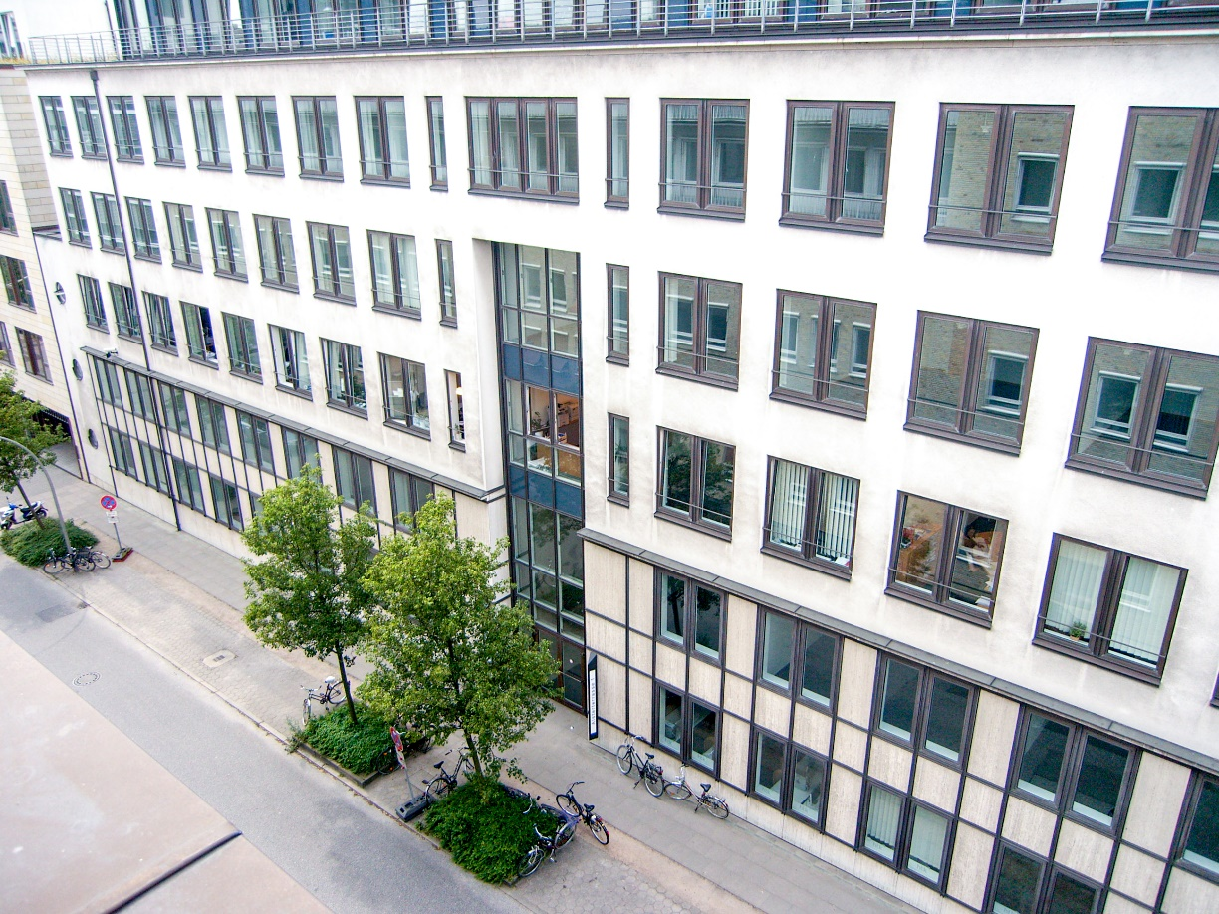
Campus Center
More Information: https://www.uni-hamburg.de/campuscenter/beratung/beratungsangebote/workshop-coaching.html
Workshops
Orientation
Motivation
Organizational skills
Mental health
Foto: UHH/ Schell
Notes:
Upcoming workshops:

Slide 25










Learning languages at the University
General languages: levels A1–B1 with course fees
University Language Center: levels B2–C2 free of charge
PIASTA: language cafés and language tandems
General Languages : Universität Hamburg (uni-hamburg.de)
University Language Center : Universität Hamburg (uni-hamburg.de)
Experiencing languages : PIASTA : Universität Hamburg (uni-hamburg.de)
Languages offered: Arabic, Chinese, Danish, Dutch, English, French, German as a foreign language, German Sign Language, Italian, Japanese, Korean, Latin, Low German, Portuguese, Russian, Spanish, Swedish, Turkish
Notes:
Allgemeinsprachen (in Kooperation mit der Volkshochschule) Zwischen 35-65€ für das ganze Semester (je nachdem, wie viele UE). In der Regel 1x/pro Woche für 2-4 Stunden.

Slide 26
4. How can I get involved in political and intercultural activities?

Slide 27
Political and inter / trans cultural involvement
AStA (student council) | PIASTA | Student associations and initiatives
Appointed by the elected student parliament Represent students in politics, administration, and public Support students with problems at the University Welcome Week, cultural courses, and political educational activities | Welcome Week Welcome Buddy Program International nights Cultural events and leisure activities Seminars and workshops Language cafés Language tandems PIASTA Support Café PIASTA : Universität Hamburg (uni-hamburg.de) | Here are just some: Internships abroad with AIESEC Make the world a better place with Enactus University Players ESGroovt Queer-Section Refugee Law Clinic Wurzelwerk – Urban Gardening Projekt
Notes:
Veranstaltungshinweis: Fragen, ob sich schon jemand angemeldet hat?
Links Student associations/initiatives:
AIESEC: https://www.aiesec.de/lcs/hamburg
Enactus: https://www.enactus.de/hamburg/en/start
The student driven Non-Profit-Initative:
With over 73.000 members Enactus is the biggest student driven Intative in the world. By founding sustainable companies and further NGOs we tackle social and ecologic problems. With this we implement the 17 UN sustainable development goals in an entrepeneurial and long lasting way.
University Players - English Amateur Theatre: https://universityplayers.de/
ES Groovt Chor: https://www.uni-hamburg.de/veranstaltungen.html?event=87550
Mention Departmental student representative committee (FSR):
Organization of orientation modules (OEs)
Student advising service for study-related matters

Slide 28
5. What leisure and recreational options does the University offer?

Slide 29

Leisure activities
Copyright: UHH/Esfandiari
University Sports | Music | Theater
Indoor Outdoor Online activities Trips and outings BEAT! (student health management) https://www.hochschulsport.uni-hamburg.de/ | Choir Orchestra Jazz band https://www.unimusik.uni-hamburg.de/mitmachen.html | University Players Kalliope Theater https://www.uni-hamburg.de/lp-oeffentlichkeit/uni-hoch-kultur/kulturformate-der-uhh.html https://www.uni-hamburg.de/campuscenter/campus-leben/freizeit.html
Notes:
University Players - English Amateur Theatre: https://universityplayers.de/

Slide 30

Free ticket for new students
For all students in the first and second semester
Valid for 4 months - from November to February
Free access to over 40 cultural institutions in the city, including:
  Elbphilharmonie, Hamburg State Opera or the Thalia Theater
  Please note that the availability of free tickets at some institutions is limited. For more information, please visit: https://meinefreikarte.de/
You can pick up your free ticket from the AStA office upon presentation of your student ID.
Foto: AStA UHH

Slide 31
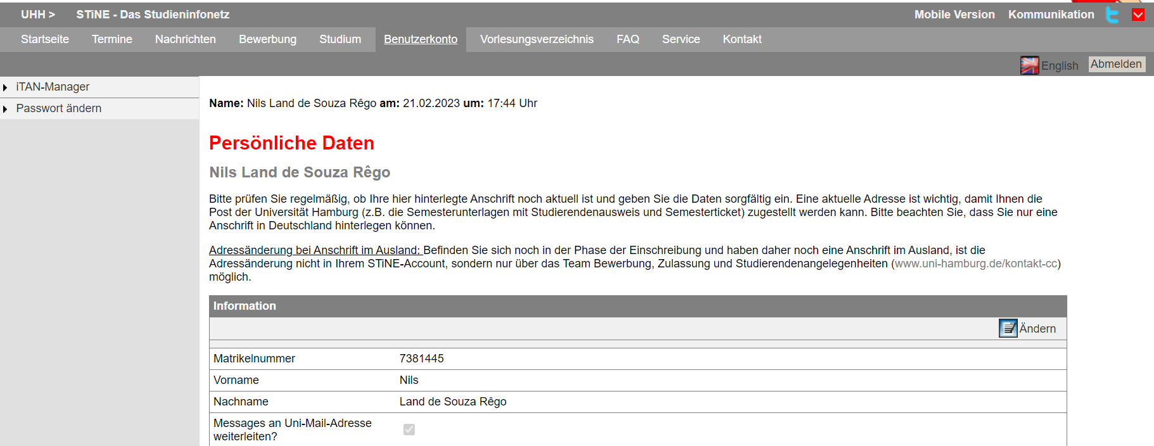
Communication
More information
STiNE
Surfmail
(@studium.uni-hamburg.de)
Not an email system—an internal news portal run by the University
Linking to Surfmail: STiNE portal → Account → Forward messages to uni-mail-account → Change
All students have their own University email address
  Instructional video to set up your student email address (DE/EN)
Important! When communicating with teaching staff, academic advisors, classmates, and any other university staff, you should always send mails using your uni-hamburg.de email address.
Linking to your private email address:
  Surfmail → Filters→ Forward → enter desired email address → Save
Notes:
Link Lehrvideo: https://www.uni-hamburg.de/newsroom/campus/2022/1011-film-studi-mailadresse.html
Stine (English): Account → activate „Forward messages to uni-mail-account“ → Change
Surfmail (English (USA)): Mail → filters → forward → enter your private Mailadress → Save
Wichtige Informationen vonseiten der Uni, von euren Dozierenden oder auch Benachrichtigungen über die Online-Tools (Agora, OpenOlat etc.) werden an Stine oder eure Surfmail geschickt. Um keine Benachrichtigung zu verpassen, ist es deshalb wichtig eine Weiterleitung an eure private Mail einzurichten.
WICHTIGER HINWEIS: Bitte überprüft nach der Verknüpfung, ob die Mails auch tatsächlich weitergeleitet werden! Schaut vorsichtshalber zu Beginn immer in beide Portale mal rein

Slide 32
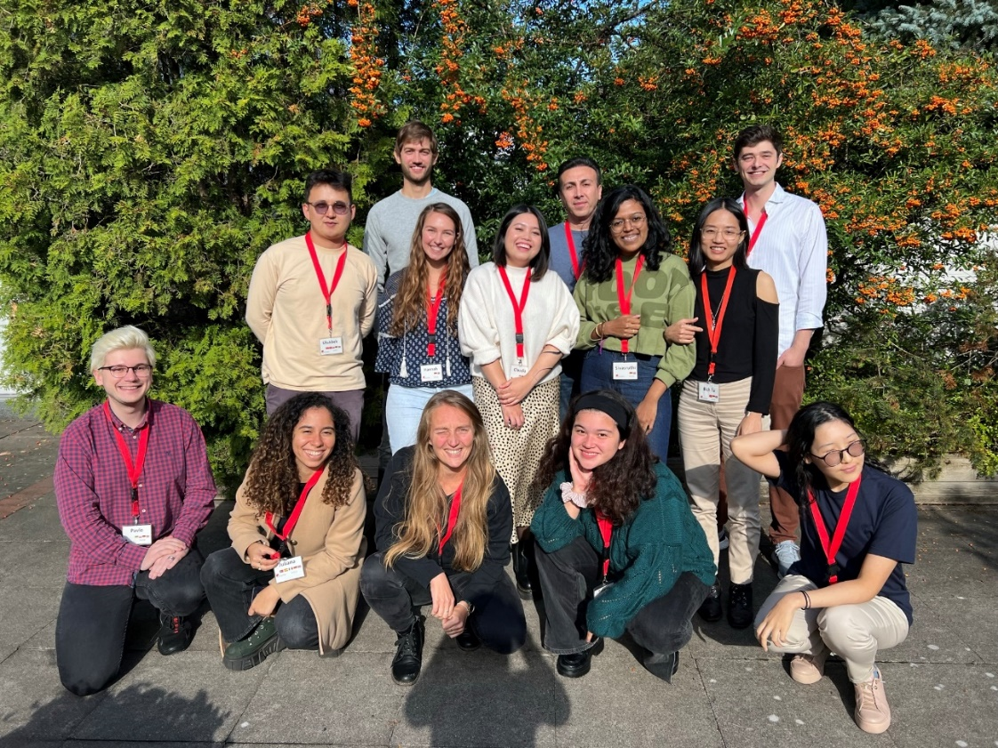

We can’t wait to meet you!
PIASTA offers during the semester:
Cultural events and leisure activities
Seminars and workshops
Language offers
For new students
Advising
International nights
Copyrights: Universität Hamburg / PIASTA
More information and registration at:
Notes:
UHH Join: https://www.uhh-join.uni-hamburg.de/de/#rvb
PIASTA: https://www.uni-hamburg.de/piasta/

Slide 33
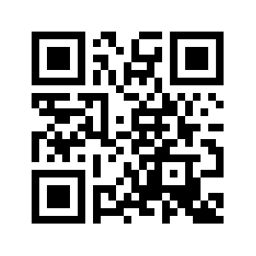

How can you stay in touch with us?
PIASTA on Instagram
Info about upcoming events and offerings
instagram.com/piastauhh
Sign up here!
PIASTA website
Overview of all our events and advisory services that we offer
You can register for all our events via UHH-Join
Newsletter
Info about upcoming intercultural learning opportunities and workshops
Job offers for students
General info about PIASTA Events
Notes:
Leuten 2-3 Min Zeit geben, sich beim Newsletter anzumelden und Folgen!
Instagram: instagram.com/piastauhh
Newsletter: https://www.uni-hamburg.de/piasta/mitmachen/newsletter.html
Website: https://www.uni-hamburg.de/piasta/
UHH Join: https://www.uhh-join.uni-hamburg.de/de/

Slide 34
Online survey about Welcome Week
We work hard to plan events and activities and would love to get your feedback.
Our team will hand out a QR code for a questionnaire at in-person events. After you have taken part in your last event of the week, let us know how the week went for you.
No QR code? No problem. At the end of Welcome Week, we can also give you an email link for the online questionnaire.
After your last event at the end of the week, take a few minutes to answer the questions.
Thank you!

Slide 35
Time for questions☺
Thank you for your time!
Notes:
Vorbereitung auf häufige Fragen bei den "eigenen" Veranstaltungen: Semesterticket, OEs, Ausländerbehörde - bei Präsentieren Wegweiser auf die Zeit achten. Genug Zeit für Fragen einplanen. (unter PPT-Notizen auf letzter Folie bei allen Info-VA einfügen)
Auf UHH.de/OE verweisen oder sonst an Studienbüro des Studiengangs verweisen
Semesterticket: Ich habe mein Ticket noch nicht erhalten – ist das schlimm oder nicht? Vergewissern, dass alle Doks eingereicht sind (Im Zulassungsbescheid nachschauen). Bei Int Stud. Insbesondere vergewissern, dass DE-Nachweise eingereicht wurden. Kann 2-3 Wochen dauern. Bei Unsicherheit ans Campus-Center wenden und nachfragen. UHH-Homepage zeigen und auf Service-Phone verweisen: https://www.uni-hamburg.de/campuscenter/beratung/info-beratung-telefon.html
Nachweise der KV müssen nicht mehr eingereicht werden, sondern die gesetzlichen geben Meldung an die Uni durch. (to-do-Broschüre durchgehen!)
Ausländerbehöre: Bei den Behörden in HH gibt es sehr lange Wartezeiten. Die beste Art der Terminbeantragung ist die Online-Beantragung, weil man da schon Online Dokumente hochladen kann. Deswegen kümmert euch frühzeitig vor Ablauf der Aufenthaltselaubnis um Termin kümmern! Keine Sorge, ihr bekommt sonst eine sog. Fiktionsbescheinigung. Damit könnte es allerdings Schwierigkeiten bei Wohnungs- und Arbeitssuche geben.
Prüfungsanmeldung: auf OE bzw. Studienbüro verweisen.

