Slide 1

How Does Studying Work?
PIASTA Welcome Week

Slide 2

Write us in the chat!
Let us know where you’re watching from and what you’re studying!
Copyright: UHH/vonWieding

Slide 3

How does studying work?
What can you expect at the start of your studies?
How is the semester structured?
What kind of courses are available?
What kind of examinations will you face?
How are degree programs organized?
What does it truly mean to study?
How to study effectively and sustainably?
Who can help you, and where can you find them?
Copyright: UHH/Wohlfahrt
Notes:
- Hinweis, dass PPT sehr voll mit Informationen ist. PPT später auf homepage verfügbar: https://www.uni-hamburg.de/piasta/welcome-buddy/welcome.html
- Geduld und verständnis, dass dies allgemeine Infos sind. Fachspezifische Infos werden in der OE behandelt.

Slide 4

1. What can you expect at the start of your studies?

Slide 5
What can you expect at the start of your studies?
Welcome Week
Orientation module
Course registration
Semester start

Slide 6
Orientation module (OE)
Important information for your subject
STiNE
Examination regulations and subject-specific provisions (FSBs)
Choosing courses with tutors
When do OEs take place?
Short cut:
www.uni-hamburg.de/oe
Or:
www.uni-hamburg.de > Studies
You are now on the Campus Center website:
> Organizing your studies > First-year info
Notes:
Subject-specific regulations (FSB) provide information about the structure of the course, such as the curricular areas, the sequence of modules to be taken (module plan), information about different types of courses, module deadlines, part-time study, semesters abroad, bachelor's thesis and grade calculation.

Slide 7
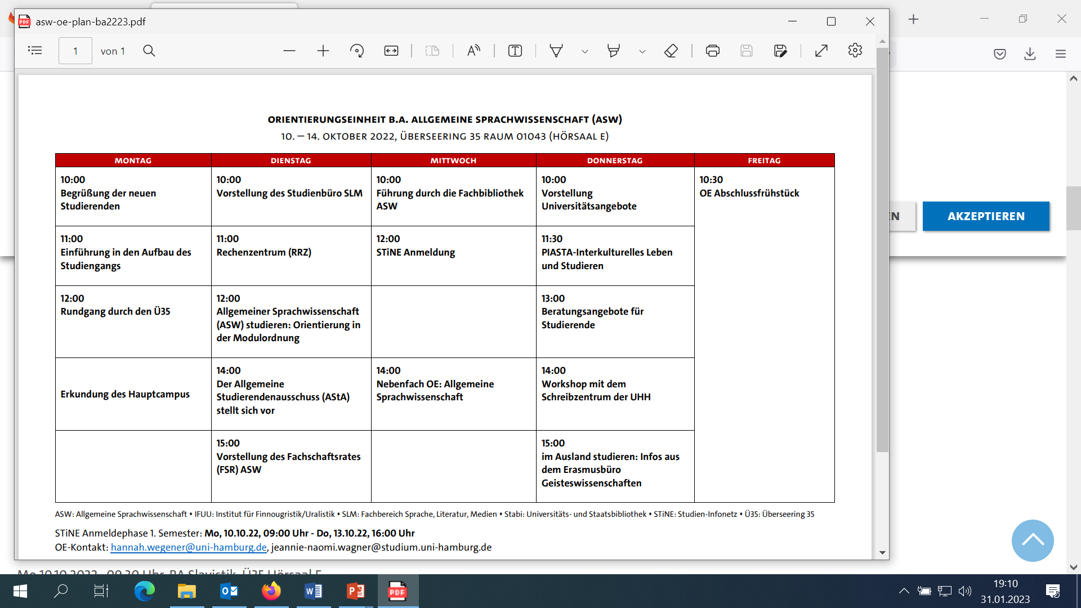
Example OE -
Allgemeine Sprachwissenschaft

Slide 8
2. How is the semester structured?

Slide 9
Timetable overview
You can find more information about the registration procedure on Stine
Welcome Week | Orientierungs-einheit (OE) | Anmeldung zu Kursen | Semesterstart | Ferien | Semesterferien/Vorlesungsfreie Zeit
29.09.25- 03.10.25 | 06.10.2025- 10.10.2025 | Erstsemester 06.10. 9 Uhr bis 09.10. 16 Uhr Ummeldung: 13.10. 9 Uhr bis 23.10. 13 Uhr | WiSe 2025_26 01.10.25 – 31.03.26 Vorlesungszeit 13.10.25- 31.01.26 | Weihnachts-ferien: 21.12.25-04.01.26 | 02.02.26 – 31.03.26
Notes:
Please note any different registration periods – ask your department. The course registration process is also covered in detail in the OE. More information on registration phases and procedures can be found here: https://www.stine.uni-hamburg.de/scripts/mgrqispi.dll?APPNAME=CampusNet&PRGNAME=EXTERNALPAGES&ARGUMENTS=-N000000000000001,-N000385,-Aanmeldephasen
Abweichende Anmeldephasen beachten – beim eigenen Fachbereich nachfragen. Das Prozedere der Anmeldung zu Kursen wird auch in der OE ausführlich behandelt. Mehr Infos zu Anmeldephasen- und Verfahren findest du hier: https://www.stine.uni-hamburg.de/scripts/mgrqispi.dll?APPNAME=CampusNet&PRGNAME=EXTERNALPAGES&ARGUMENTS=-N000000000000001,-N000385,-Aanmeldephasen

Slide 10
How is the semester structured?
Lecture period
Weekly courses and block courses
Preparing for and following up on courses
Working in study groups
Documenting completed coursework
Preparing for and taking exams
Revision period
No courses
Time for internships
Time for term papers
Exams (depending on faculty)

Slide 11
3. What types of courses are available?

Slide 12
What kind of courses are there?
Weekly courses
90 minutes, once per week
Practical courses, tutorials, lab work ...
Block courses
Individual appointments throughout the semester
Lectures
Seminars
Several hours at a time

Slide 13
What kind of courses are there?
Lecture
Many students
Written examination
Lecture hall or online
Professors
Seminar
10–30 students
Research associates
Group work
Presentations
Term paper
10–25 students
In addition to other courses
Tutors
In-depth exercises
Practical course / tutorial / lab work
Copyright: UHH/Dichant
Copyright: UHH/vonWieding
Copyright: UHH/Dingler

Slide 14

Scheduling at the University
12 s.t.
s.t. = sine tempore (Latin)
This indicates that the course begins punctually on the hour.
12 s.t.
= 12 pm
12 c.t.
c.t. = cum tempore (Latin)
This indicates that the course begins 15 minutes after the hour (academic quarter).
12 c.t.
= 12:15 pm
Copyright: UHH/PIASTA

Slide 15
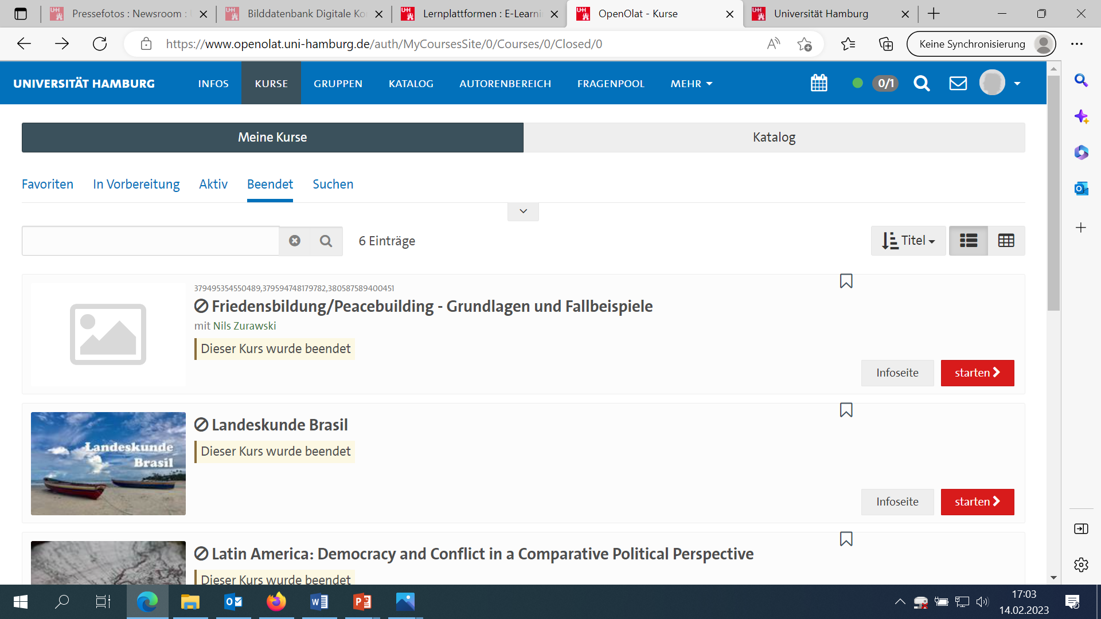
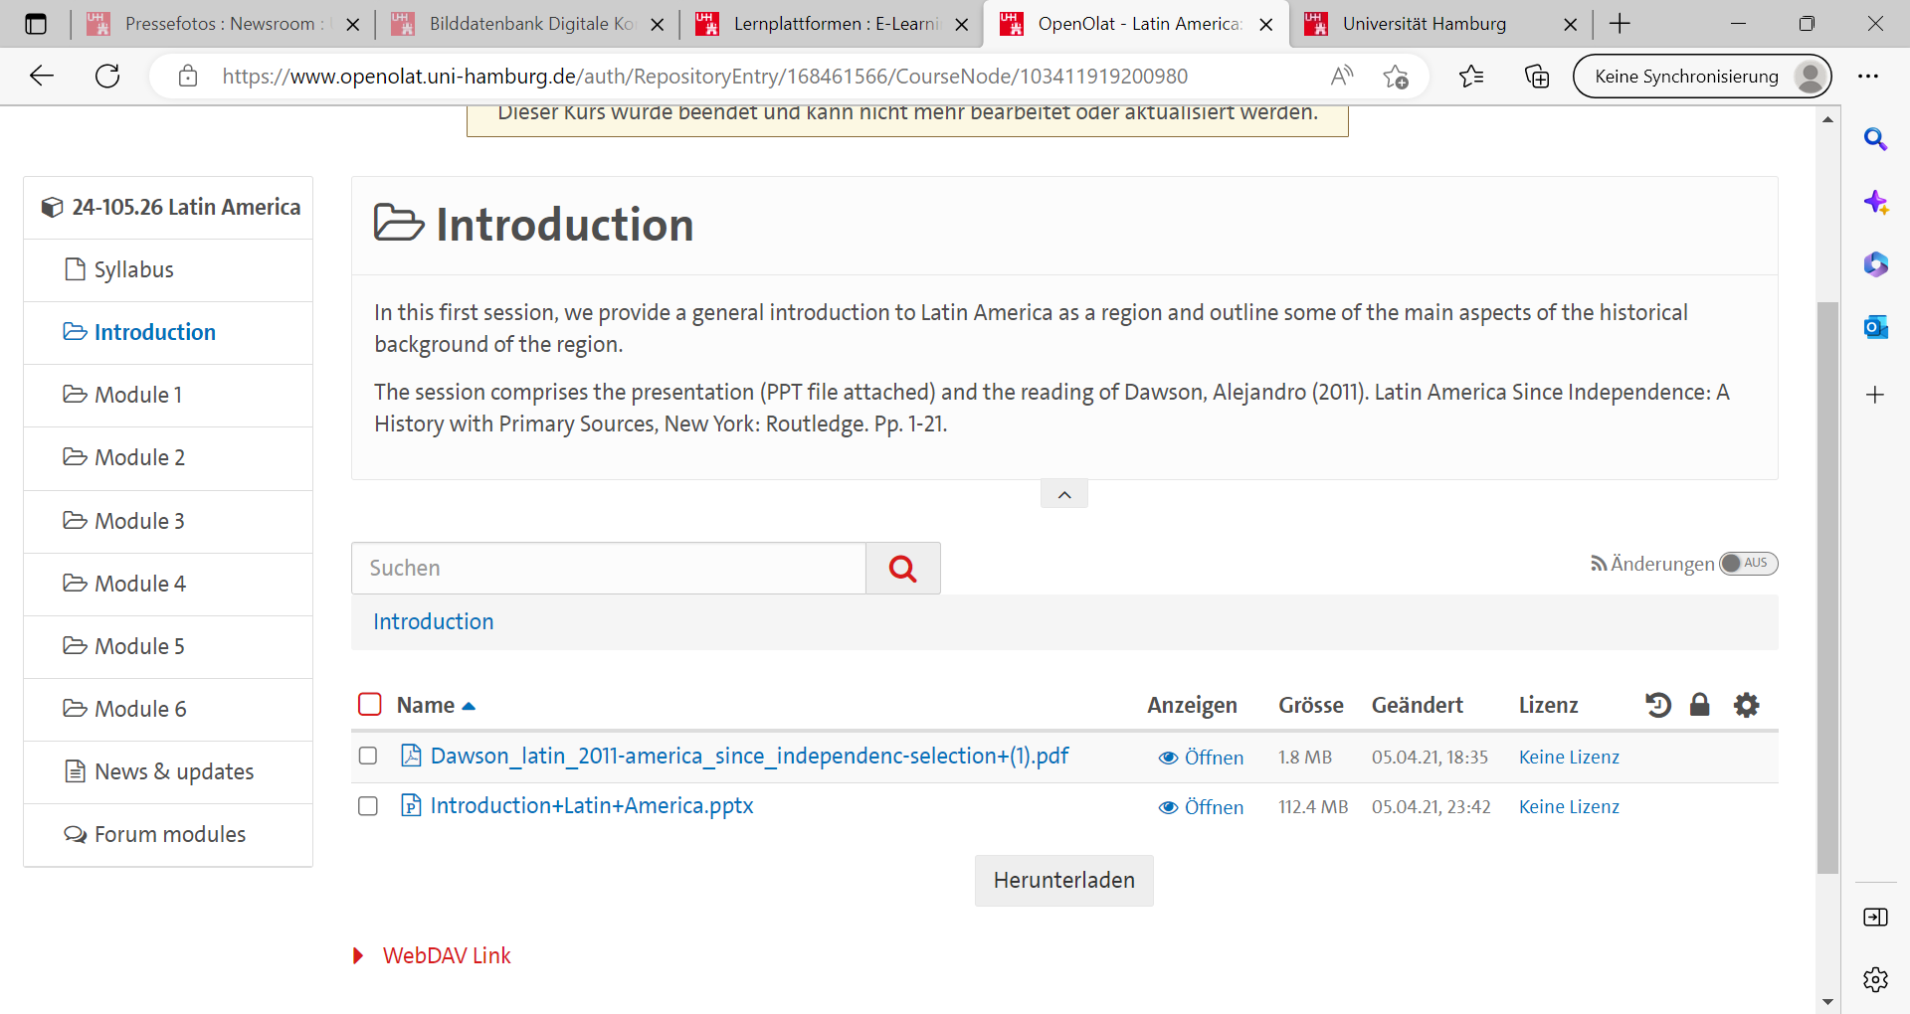
Online learning platforms at Universität Hamburg
E-learning portal: www.uni-hamburg.de/elearning.html
OpenOlat
Agora
CommSy
STiNE
Mephisto
Moodle
Notes:
- CommSy (including Agora) is the communication and collaboration platform ideal for beginners. Different platforms vary depending on the faculty.
OpenOLAT is a high-level learning management platform that can be used to create even complex online courses. It is particularly suitable for VAs with a wide range of learning materials and online tests, as well as for submitting assignments.
On Mephisto, you will find the eLearning offerings that accompany face-to-face teaching at the University Medical Center Hamburg-Eppendorf.
This is the Moodle instance of the MIN faculty. By connecting tools such as CAS Maxima or CodeRunner, this learning platform enables exciting teaching scenarios, especially for MIN subjects.
STiNE is used to capture all essential processes in the areas of teaching and studying on a single IT platform. This includes applying for a place at university, registering for courses and exams, and managing exam results.
- CommSy (inkl. Agora) ist die Kommunikations- und Kollaborationsplattform, die ideal für den Einstieg geeignet ist. Unterschiedliche Plattformen je nach Fakultät.
OpenOLAT ist eine High-Level-Learning Management Lernplattform, mit der man auch komplexe Online-Kurse gestalten kann. Besonders geeignet für VA mit breitem Angebot an Lernmaterialien und Online-Tests. Und zur Abgabe von Aufgaben.
Auf Mephisto finden Sie die eLearning-Angebote, die den Präsenzunterricht am Universitätsklinikum
Hamburg-Eppendorf begleiten.
Dies ist die Moodle Instanz der MIN-Fakultät. Durch die Anbindung von Werkzeugen wie das CAS Maxima oder CodeRunner sind mit dieser Lernplattform insbesondere für die MIN-Fächer spannende Lehrzszenarien umsetzbar
STiNE dient dazu, alle wesentlichen Prozesse im Bereich von Lehre und Studium auf einer einzigen IT-Plattform zu erfassen. Dazu gehören die Bewerbung auf einen Studienplatz, die Anmeldung zu Lehrveranstaltungen und zu Prüfungen sowie die Verwaltung von Prüfungsergebnissen.

Slide 16
4. How are degree programs organized?

Slide 17
How are degree programs organized?
Subject-specific provisions (FSBs)
Program structure
Examination regulations
Recognition and accreditation of coursework and examinations
Admission to examinations
Thesis or something similar
Module descriptions
Calculation of grades
Regular period of study
Notes:
Please read these guidelines in a timely manner. You can find them on the department's website. If in doubt, contact the Student Affairs Office or the respective supervisor.
Hinweis, diese sich rechtzeitig durchzulesen. Findet man auf der Seite vom Fachbereich. Im Zweifel Studienbüro oder Betreuer der jeweiligen VA kontaktieren

Slide 18
How are degree programs structured?
Modules
Required modules
Elective area
Courses taken in addition to required courses
ECTS credits
ECTS credits
Required elective modules
Credit points
1 ECTS credit = approx. 30 hours of work (e.g., participation and exam preparation)
Multiple courses and examinations
One or two semesters
Notes:
When registering for courses in STiNE, it's important to pay attention to which module you're booking a particular course. For example, you can sometimes register for the same course either with or without an exam. (see next slide)
Elective Area: In many degree programs, ECTS credits can also be earned through elective areas.
We recommend taking advantage of this offer and using your studies to explore content outside of your own subject area. For example, language courses offered by the Language Center or participation in subject conferences may also be credited. For more detailed information, contact your department's student services office.
Bei der Anmeldung zu Kursen in STiNE ist es wichtig darauf zu achten zu welchem Modul man eine bestimmte VA bucht. So kann man sich z.B. zu demselben Kurs manchmal entweder mit oder ohne Prüfung anmelden. (siehe nächste Folie)
Wahlbereich: In vielen Studiengänge können ECTS auch über den Wahlbereich erlangt werden.
Empfehlung das Angebot wahrzunehmen und so das Studium auch dafür zu nutzen Inhalte außerhalb des eigenen Fachbereichs kennenzulernen. So können u.a. auch Sprachkurse des Sprachenzentrums oder die Teilnahme an Fachkonferenzen ggf. angerechnet werden. Für genauere Informationen informiere dich bei dem Studienbüro deines Fachbereichs.

Slide 19
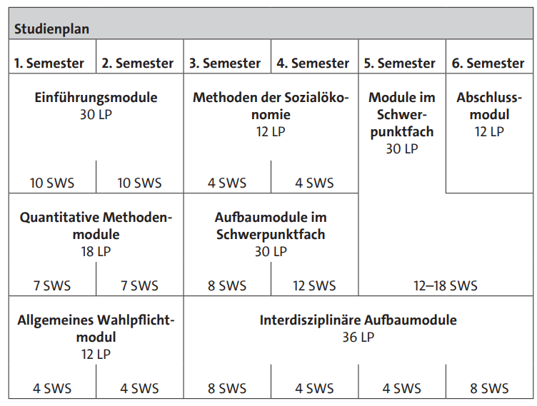
Degree plan (FSBs)
Example:
BA in Socioeconomics
“SWS” = credit hours per week
“LP” = ECTS credits
2 SWS = 1.5 hrs. per week
1 LP = time expenditure of 30 hours
Notes:
Subject-specific regulations (FSB) provide information about the structure of the course, such as the curricular areas, the sequence of modules to be taken (module plan), information about different types of courses, module deadlines, part-time study, semesters abroad, bachelor's thesis and grade calculation.
Fachspezifischen Bestimmungen (FSB) geben Auskunft über den Aufbau des Studiums, wie z.B. über die Curricularbereiche, die Abfolge der zu belegenden Module (Modulplan), Informationen über verschiedene Lehrveranstaltungsarten, Modulfristen, Teilzeitstudium, Auslandssemester, Bachelorarbeit und Notenberechnung.

Slide 20
5. What kind of examinations will you face?

Slide 21
What kind of examinations are there?
Coursework
Not graded
Presentations, portfolios, and smaller written work, for instance
Examinations
Graded
Written examinations, oral examinations, and term papers
Inform yourself in time about the
formal requirements (deadlines, citation etc.)!
You can find more information in the examination and study regulations of your faculty and in your Stine account!
Notes:
- Observe cancellation deadlines; risk losing your exam attempt
- Pay attention to submission deadlines
- Abmeldefristen beachten; Risiko Prüfungsversuch zu verlieren
- Auf Abgabefristen achten

Slide 22
What kind of examinations are there?
Written examination
Usually at the end of lectures
Term paper
Focus on a specific topic
Agreed-upon topic
Oral examination
Questions/
discussion
Duration of, e.g.,15–30 minutes
Consultations during office hours
Line of inquiry and literature searches
Deadlines
Academic work/writing
Multiple choice
Written tasks

Slide 23
6. What does it truly mean to study?

Slide 24
What does it truly mean to study?
Independent study
(Bibliographic) research
Preparation and follow-up
Examination preparation
In-depth work on topics
Reading
Attendance
Seminars, lectures, tutorials, ...
Group work
Internships and lab work
Notes:
Studying is more than studying
- Studying is about learning to learn (how do I acquire knowledge? How do I structure it? etc.)
- Discovering/developing your own interests
Promote extracurricular activities = use your studies to explore topics outside your field (learning languages, workshops, etc.)
Some degree programs award ECTS credits for this.
It's a privilege that access to such extra knowledge is usually free for students.
Be brave to fail. Try things out.
Studying is more than studying
- Studium als Lernen zu lernen (wie eigne ich mir Wissen an? Wie strukturiere ich es? etc.)
- Entdecken/Entwicklung eigener Interessen
Werbung machen für extracurriculare VA = Studium nutzen, um sich mit "fachfremden" Themen auseinanderzusetzen (Sprachen lernen, Workshops etc.)
Einige Studiengänge vergeben ECTS dafür.
Privileg, dass Zugänge zu solchem Extrawissen für Studierende meist kostenfrei ist
Be brave to fail. Try things out.

Slide 25
7. How to study effectively and sustainably?

Slide 26
How can you actively shape your studies?
Independent study
Time management
Jobs related to your studies
Planning internships and stays abroad
Course options
Reflection
Notes:
Studying can be very demanding, and it's perfectly "normal" to feel overwhelmed at times. It's a huge challenge to suddenly be able to deal with all the freedom (online learning materials, flexible schedule, etc.) with self-discipline.
Encourage students to contact the relevant contact points and seek support (see below).
Tip: If you can afford it (student financial aid, residency regulations), don't put yourself under pressure to complete the program within the standard period. This way, you can also use your studies to explore and explore your own interests and practical experiences.
Ein Studium kann sehr fordernd sein und es ist ganz "normal", wenn es einen mal überfordert. Große Herausforderung, auf einmal selbstdiszipliniert mit den ganzen Freiheiten (Online-Lehrmaterialien, flexibler Stundenplan etc.) umzugehen.
Ermutigen, die dafür zuständigen Anlaufstellen aufzusuchen und sich Unterstützung zu suchen (siehe weiter unten)
Tipp: Falls du es dir erlauben kannst (Bafög, Aufenthaltsregelung), setze dich mit der Regelstudienzeit nicht unter Druck. Sodass du das Studium auch zum Kennenlernen und Ausprobieren eigener Interessen und praktischen Erfahrungen nutzen kannst

Slide 27
Reflecting on your studies and defining goals
It is a good idea to clarify your goals and motivation.
Ask yourself these questions:
What is fun about my studies?
What skills do I want to acquire?
What can I do to reach my goals?

Slide 28
Tips on managing your time
Info-Event – Academic writing and how the writing center can help
Thursday, 02.10.25,
11:30 AM in English
Register on UHH Join
Important: Plan your semester! What duties and deadlines are there? What do you want to decide yourself?
Think about what you want to learn or do and in which order, and then make a plan.
Set weekly and daily goals—be realistic and do not take on too much.
Finish up your notes during the lecture/seminar and revise them afterwards.
Formulate the main points of texts directly after reading.
For further tips, check out the workshops and consulting services of the writing center
Notes:
Schreibzentrum/writing center mit hilfreichen Workshops (siehe unten)

Slide 29
Resources for time management and reflection
Literature:
Bastian, Jasim / Groß Mlynek, Lena (2018): Lerntechniken und Wissensmanagement: Wissen erwerben, speichern und verwerten, Konstanz: UVK.
Sutoris, Martin (2018): Der Uni-Coach. So kommst du entspannt, motiviert und erfolgreich durch dein Studium, Berlin: Springer Verlag.
Studienwissen: Tipps für Erfolg im Studium | e-fellows.net
Podcasts:
Tipps auf Augenhöhe (tipps-auf-augenhoehe.de)
Studis Online (studis-online.de)
Studium mit Rückenwind (podomatic.com)

Slide 30
Resources for time management and reflection
PIASTA cooperation project:
StudienPerspektiven blog:
https://studienperspektiven.check.uni-hamburg.de/
Extracurricular (voluntary) workshops in faculties and centralized institutions—on STiNE and UHH Join

Slide 31
7. Who can help you, and where can you find them?

Slide 32
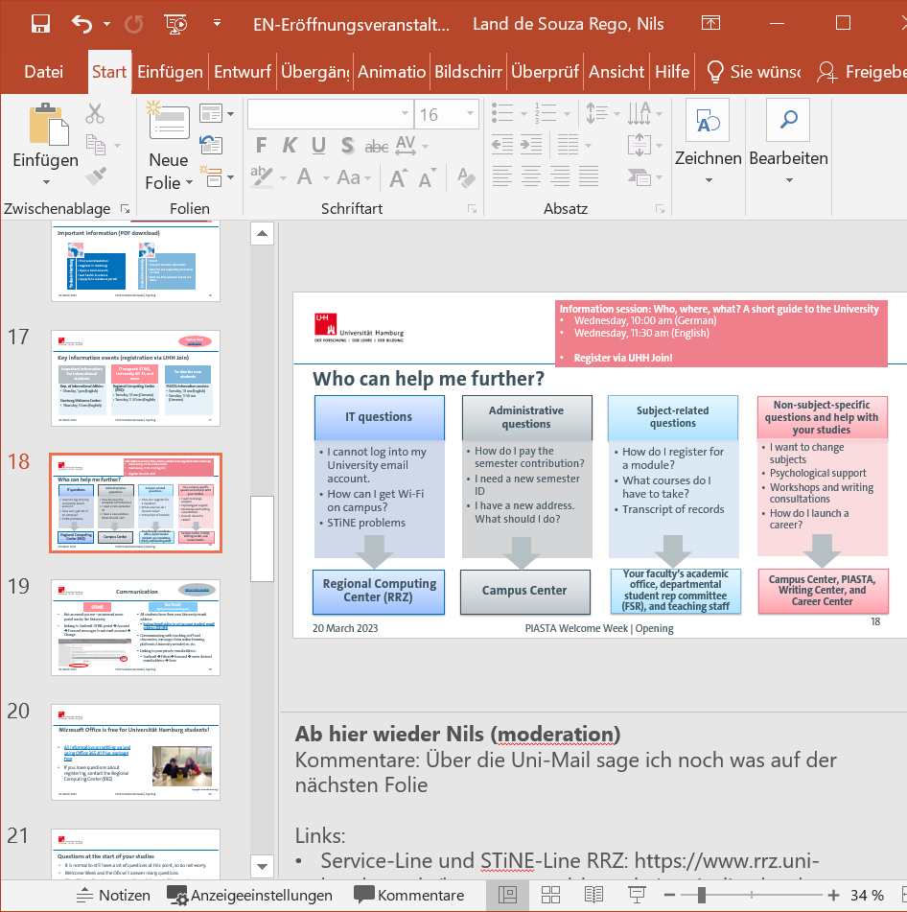
Who can help me further?
Notes:
Campus Center: https://www.uni-hamburg.de/campuscenter/beratung/beratungsangebote/studienberatung.html
Schreibzentrum: https://www.isa.uni-hamburg.de/schreibzentrum.html
PIASTA: https://www.uni-hamburg.de/piasta.html
Studierendenwerk: https://www.stwhh.de/unsere-beratungsangebote
AStA: https://www.asta-uhh.de/2-beratung.html
RRZ: https://www.rrz.uni-hamburg.de/beratung-und-kontakt.html

Slide 33
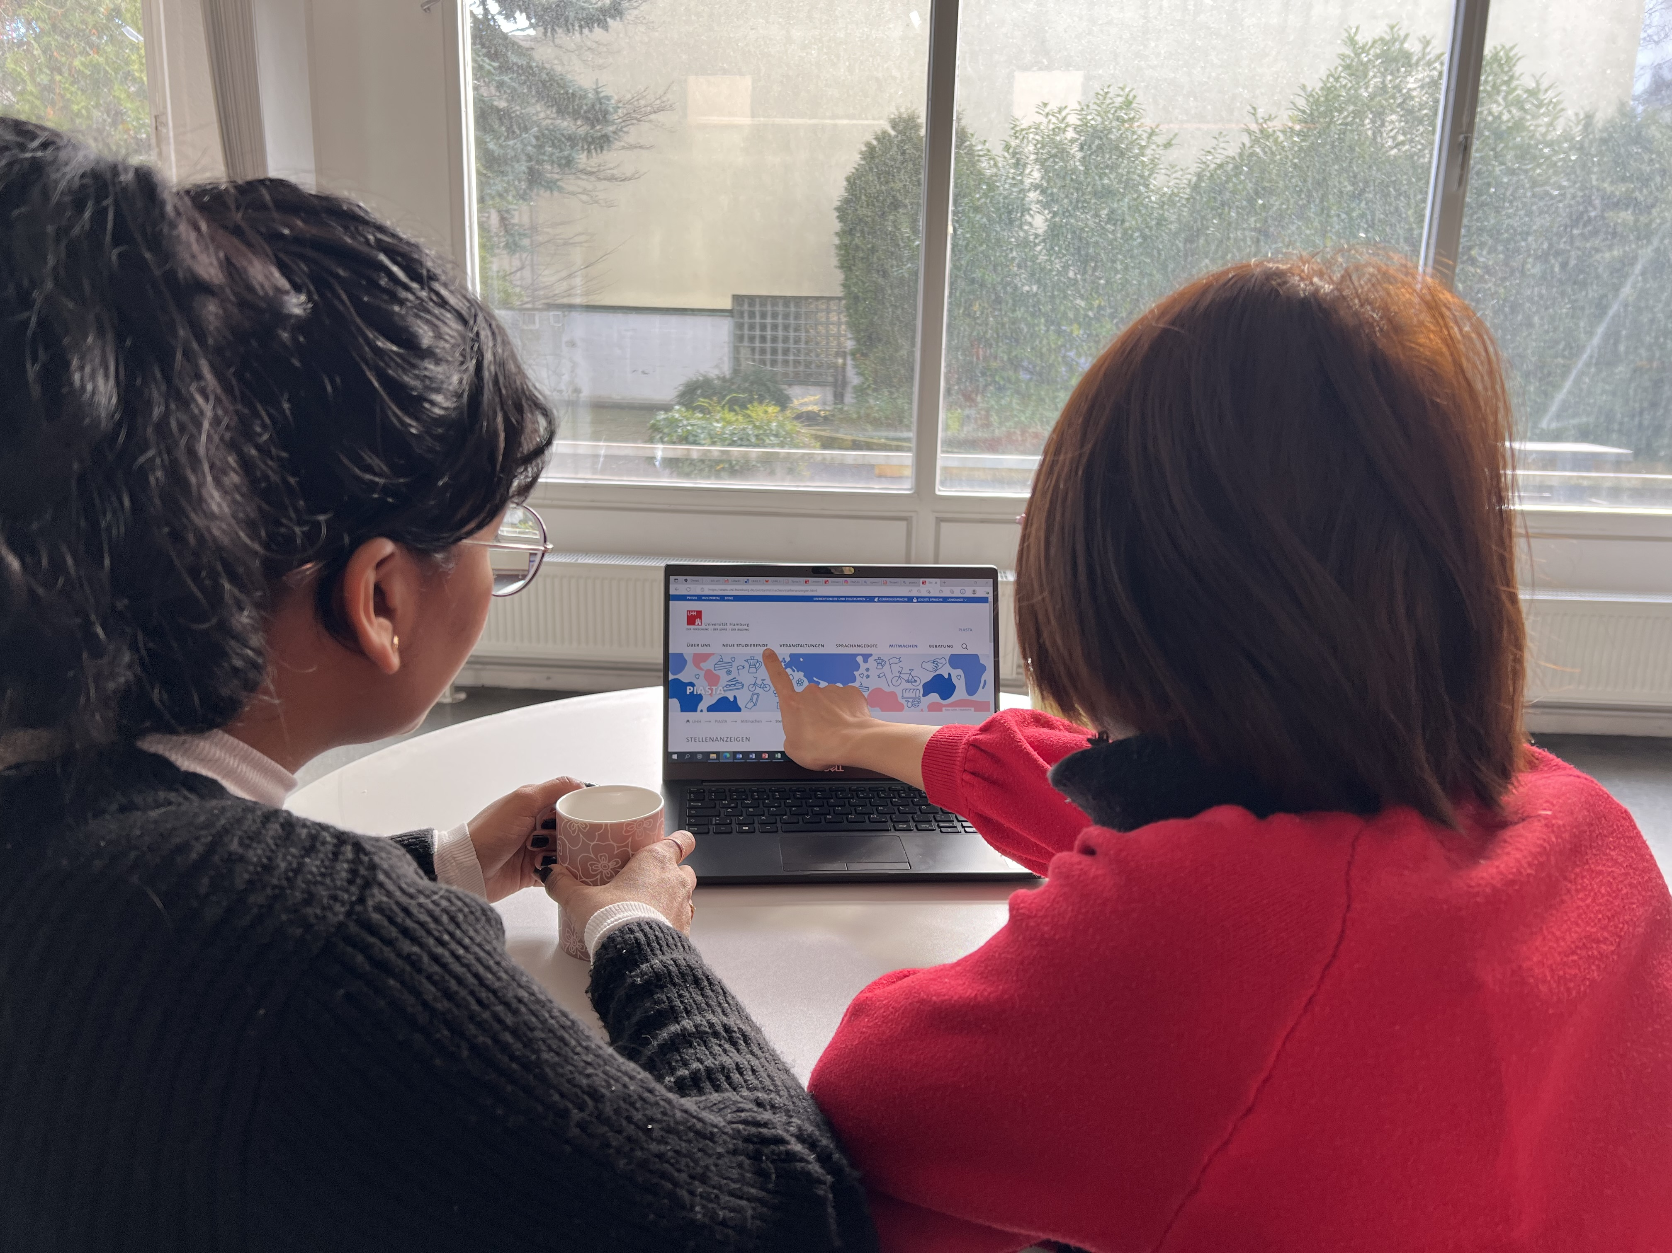
Did you miss an event during Welcome Week?
No problem!
See the PIASTA Welcome Week page to download all important information:
Online campus tour
To-Dos brochures for new students
Presentation slides of all online events
during PIASTA Welcome Week Among other things:
  Who, What, Where? A short guide to the University
  Working While Studying—What Do I Need to Know?
  Academic Writing During Your Studies—
  Tips from the Writing Center
  . . .
PIASTA tour guides
  Campus tour (von-Melle-Park)
  Hamburg by Night tours (St. Pauli, Sternschanze, and more)
Copyrights: Universität Hamburg / PIASTA
Notes:
Link: https://www.uni-hamburg.de/piasta/welcome-buddy/welcome.html
To-Do-Broschüre: https://www.uni-hamburg.de/piasta/welcome-buddy/to-dos-fuer-neue-studierende.html

Slide 34
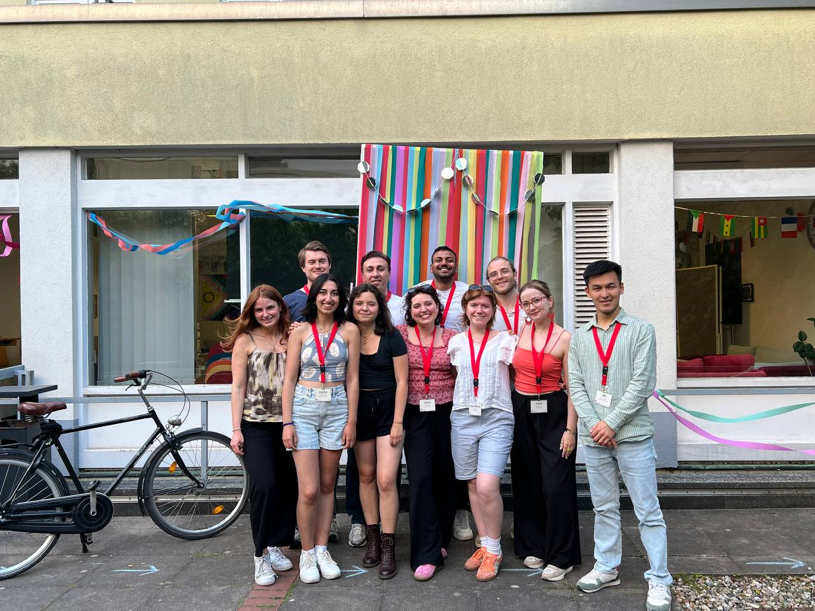

We can’t wait to meet you!
PIASTA offers during the semester:
Cultural events and leisure activities
Seminars and workshops
Language offers
For new students
Advising
International nights
More information and registration at:
Copyrights: Universität Hamburg / PIASTA
PIASTA Welcome Week | How Does Studying Work?
Notes:
UHH Join: https://www.uhh-join.uni-hamburg.de/de/#rvb
PIASTA: https://www.uni-hamburg.de/piasta/

Slide 35
Who helps when and where?
Central points of contact
Help with studies (advice and workshops)
Campus Center / Academic Advising
Writing Center
PIASTA
Social, financial, and legal advising
Studierendenwerk Hamburg
AStA (student council)
IT services at the University
Regional Computing Center (RRZ)
Departmental contacts
Academic office
Departmental student representative committee (FSR)
Lecturers

Slide 36
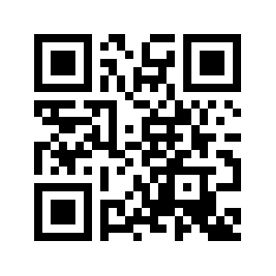

How can you stay in touch with us?
PIASTA on Instagram
Info about upcoming events and offerings
instagram.com/piastauhh
Sign up here!
PIASTA website
Overview of all our events and advisory services that we offer
You can register for all our events via UHH-Join
Newsletter
Info about upcoming intercultural learning opportunities and workshops
Job offers for students
General info about PIASTA Events
Notes:
Leuten 2-3 Min Zeit geben, sich beim Newsletter anzumelden und Folgen!
Instagram: instagram.com/piastauhh
Newsletter: https://www.uni-hamburg.de/piasta/mitmachen/newsletter.html
Website: https://www.uni-hamburg.de/piasta/
UHH Join: https://www.uhh-join.uni-hamburg.de/de/

Slide 37
Online survey about Welcome Week
We work hard to plan events and activities and would love to get your feedback.
Our team will hand out a QR code for a questionnaire at in-person events. After you have taken part in your last event of the week, let us know how the week went for you.
No QR code? No problem. At the end of Welcome Week, we can also give you an email link for the online questionnaire.
After your last event at the end of the week, take a few minutes to answer the questions.
Thank you!

Slide 38
Time for questions☺
Thank you for your time!
Notes:
Prepare for frequently asked questions at your "own" events: Semester ticket, OEs, Immigration Office - pay attention to the time when presenting. Allow enough time for questions. (Include under PPT notes on the last slide of all informational events)
Refer to UHH.de/OE or refer to the Student Office for your program.
Semester ticket: I haven't received my ticket yet – is that a problem? Make sure all documents have been submitted (check your admission letter). For International Student: Make sure, in particular, that your German certificates have been submitted. This can take 2-3 weeks. If unsure, contact the Campus Center and ask. Show the UHH website and refer to the service hotline: https://www.uni-hamburg.de/campuscenter/beratung/info-beratung-telefon.html
Proofs from the health insurance provider no longer need to be submitted; the statutory certificates will be forwarded to the university. (Read the to-do brochure!)
Immigration Office: There are very long waiting times at the immigration offices in Hamburg. The best way to request an appointment is online, as you can upload documents online. Therefore, make sure you book an appointment well in advance of your residence permit expiring! Don't worry, otherwise you'll receive a so-called "fiktionsbescheinigung" (certificate of fiction). However, this could cause difficulties in finding housing and employment.
Exam registration: Refer to the OE or Student Office.
PPT will be available later on the website: https://www.uni-hamburg.de/piasta/welcome-buddy/welcome.html
Vorbereitung auf häufige Fragen bei den "eigenen" Veranstaltungen: Semesterticket, OEs, Ausländerbehörde - bei Präsentieren Wegweiser auf die Zeit achten. Genug Zeit für Fragen einplanen. (unter PPT-Notizen auf letzter Folie bei allen Info-VA einfügen)
Auf UHH.de/OE verweisen oder sonst an Studienbüro des Studiengangs verweisen
Semesterticket: Ich habe mein Ticket noch nicht erhalten – ist das schlimm oder nicht? Vergewissern, dass alle Doks eingereicht sind (Im Zulassungsbescheid nachschauen). Bei Int Stud. Insbesondere vergewissern, dass DE-Nachweise eingereicht wurden. Kann 2-3 Wochen dauern. Bei Unsicherheit ans Campus-Center wenden und nachfragen. UHH-Homepage zeigen und auf Service-Phone verweisen: https://www.uni-hamburg.de/campuscenter/beratung/info-beratung-telefon.html
Nachweise der KV müssen nicht mehr eingereicht werden, sondern die gesetzlichen geben Meldung an die Uni durch. (to-do-Broschüre durchgehen!)
Ausländerbehöre: Bei den Behörden in HH gibt es sehr lange Wartezeiten. Die beste Art der Terminbeantragung ist die Online-Beantragung, weil man da schon Online Dokumente hochladen kann. Deswegen kümmert euch frühzeitig vor Ablauf der Aufenthaltselaubnis um Termin kümmern! Keine Sorge, ihr bekommt sonst eine sog. Fiktionsbescheinigung. Damit könnte es allerdings Schwierigkeiten bei Wohnungs- und Arbeitssuche geben.
Prüfungsanmeldung: auf OE bzw. Studienbüro verweisen.
PPT später auf homepage verfügbar: https://www.uni-hamburg.de/piasta/welcome-buddy/welcome.html

